Slide 1
Weekly puzzles

Slide 2
3.00 3.70 3.85 ?
1
Add a £ sign in front of each value
Hint 1
Hint 2
What coins are needed to make £3
Solution
£2 + £1 = £3.00
5op + 20p = 70p
10p + 5p = 15p
2p + 1 = 3p
£3.88

Slide 3
2
Hint 1
You can turn the switches on and off as many times as you choose.
Hint 2
Types of energy
Solution
Turn 2 switches on and wait.
Turn one of the switches off and teleport.
1 bulb will be hot and off, 1 on and 1 off.

Slide 4
Which is the odd one out
3
Hint 1
Look at each shape individually
Hint 2
Write down every shape that you think is the odd 1 out and why.
Solution
The first shape is the odd one out for being the only shape that is not the odd one out.

Slide 5
22+4=24 13+6=16 80+2=82 67+9=??
4
Not all the numbers are used
Hint 1
Hint 2
Each row is important, but each ____ is not.
Answer = 69
concatenate the first digit of the first number with the second number.
Solution

Slide 6
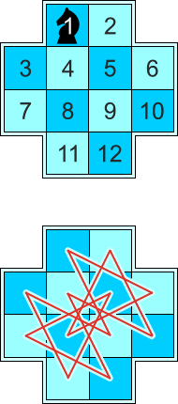
The knight must touch every square on the board without repeating a space.
5
Writing it down will be easier.
Hint 1
There is a pattern to problem.
Hint 2
Solution

Slide 7
6
There is a simple pattern
Hint 1
Hint 2
Trying looking at this from another angle
Solution
Answer 87.
Looking upside we can see the spaces are in order from 86 to 91.

Slide 8
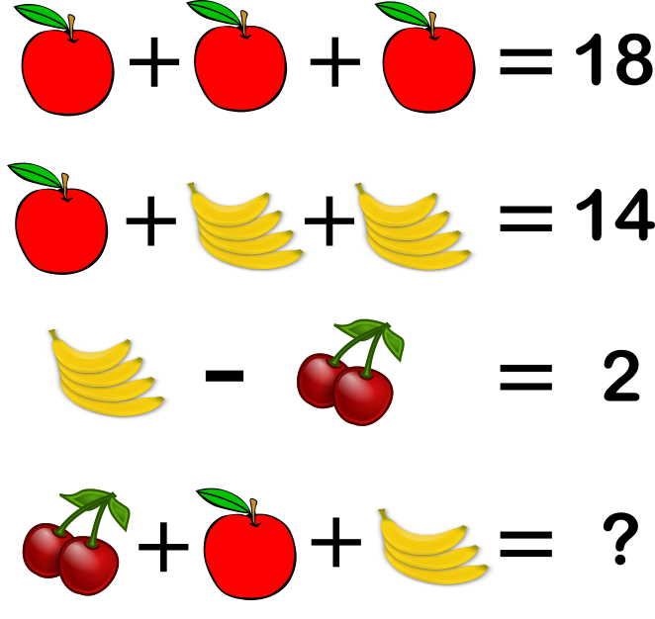
7
Start by working out the value of the apple
Hint 1
Hint 2
The answer is not 12
Solution
Answer 11
Cheery – 2
Apple – 6
Banana – 1 (per banana)

Slide 9
Divide this cake into 8 equal pieces with 3 cuts
8
The cuts are all straight
Hint 1
Hint 2
Cakes are not 2 dimensional
Solution
First cut a cross into the cake
Then cut the cake in half splitting the top and bottom
8 equal slices though some people do not get icing

Slide 10
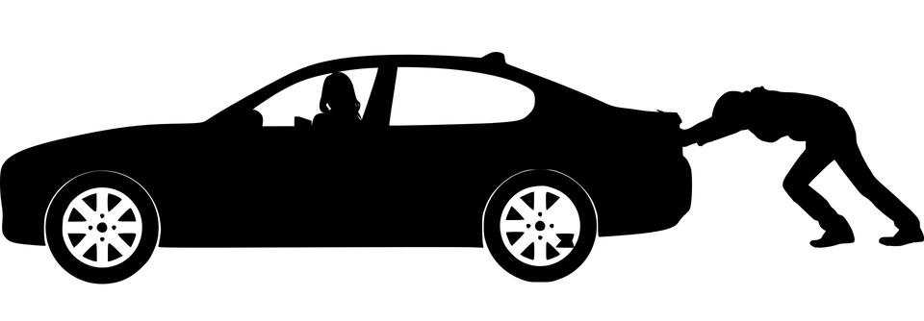
A man is pushing his car towards a hotel. He then realises he is bankrupt… how?
9
It is not a real car
Hint 1
It is not real money
Hint 2
Solution
The man is playing a game of monopoly.
He is pushing his car with his finger and has landed on someone's hotel.

Slide 11
10
There are 3 different answers
Hint 1
Hint 2
You will need to make different numbers as well as signs.
8 - 4=4
5+4 = 9
0 + 4 = 4
Solution

Slide 12
6 + 4 = 210 9 + 2 = 711 8 + 5 = 313 5 + 2 = 37 7 + 6 = 113 9 + 8 = 117 10 + 6 = 416 15 + 3 = 1218 ?? + ?? = 123
11
Hint 1
Each row is independent from each other
Hint 2
There 2 parts to each row. The second part is adding.
Solution
Answer = 12+11
(6-4 = 2) (6+4 = 10)
210
(12-11 = 1) (12+11=23)
123

Slide 13
How Can 8 + 8 = 4 ?
12
What comes around, goes around
Hint 1
800+800=1600
Hint 2
Solution
We are dealing with time. 8am plus 8 hours = 4pm.

Slide 14
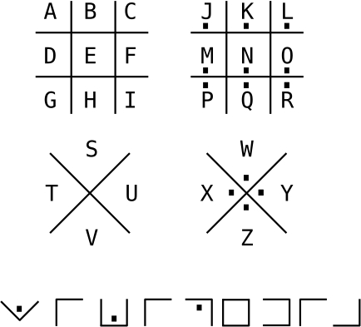
13
Hint 1
What does the bottom line say?
Hint 2
If there is a box look up.
If there is a dot, look right.
Solution
Wikipedia
Knowing the answer you can work backwards to see how to get each letter.

Slide 15
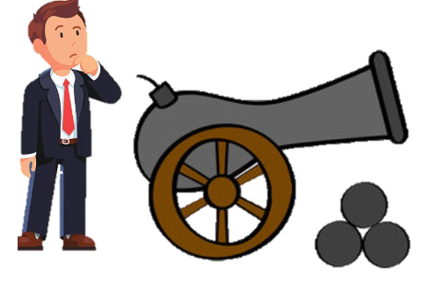
Tim fires the cannon and even though the cannon ball travels over a mile it still hits Tim… How?
14
Hint 1
Tim does not move
Hint 2
The cannon ball hits Tim in the head
Solution
Tim shoots the cannon straight up in the air. After it travels a mile, it falls back down.

Slide 16
Is the next dice a 3 or a 6?
15
Hint 1
There is a pattern to this puzzle
Hint 2
The pattern is 1,2,3,4,5,6
Solution
Answer = 6
By looking only at the top row, we can see the dots are grouped together and there values increment.

Slide 17
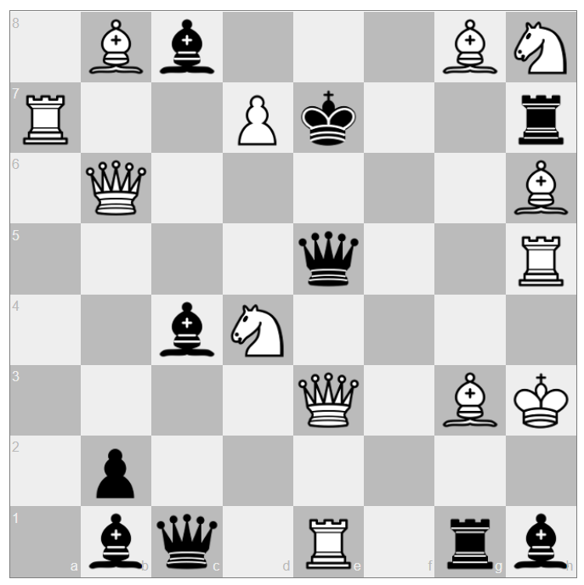
Get a checkmate in 1 move. You are white.
16
Hint 1
White start from the top of the board. There is only 2 answer.
Hint 2
A queen must be moved for 1 of the solutions
Solution
1st solution – Queen at the bottom to A3
2nd solution – Move the top pawn forward and turn it into a queen.

Slide 18
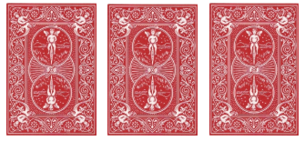
There are three playing cards in a row. There is a two to the right of a king. There is a diamond to the left of a spade. There is an ace to the left of a heart. There is a heart to the left of a spade. Identify the three cards.
17
Hint 1
This is easier to do with pen and paper
Hint 2
Start by working out the cards without the suits
Solution
Ace of Diamonds, a King of Hearts, and a Two of Spades.

Slide 19
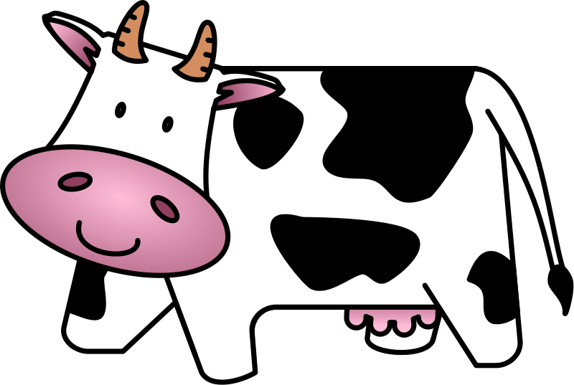
A cow is tied to a 4 meter long rope. There is food 20 meters away from the cow. However, the cow manages to go to the food and eat it. How come?
18
Hint 1
The 4M rope is tied to the cow
Hint 2
No more hints for this one
Solution
The rope is tied to the cow but nothing else.

Slide 20
A woman was standing in her hotel room, when somebody knocked on the door. When she opened the door, there was a man who said that he thought this was his room, apologized, and continued down the corridor. When the woman closed the door, she called security to warn them about the thief. Why did she think the man was planning to rob her?
19
The man thought the room was his
Hint 1
How do you normally get into a hotel room?
Hint 2
The man knocked at the door. If he thought it was his room he would of used a key or a hotel card and just enter the room.
Solution

Slide 21
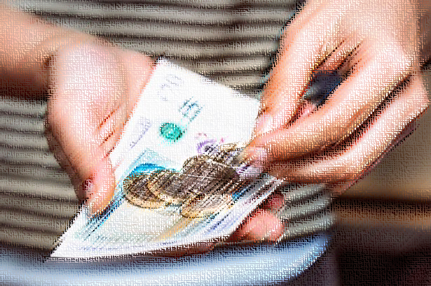
A special transaction A man buy £11.12 worth of items and pays with a £50 note. What is special about his change?
20
The man received £38.88 in change
Hint 1
The number is not important, the change however is
Hint 2
Every note and coin is used in the change.
£20+£10+£5+£2+£1+50p+20p+10p+5p+2p+1p = £38.88
Solution

Slide 22
0 0 0 0 – 4 1 7 5 2 – 0 1 8 7 9 – 3 2 0 6 1 – 2 3 1 4 1 – 0 4 0 9 6 – 3 7 7 7 7 – 0 9 9 7 3 – 2 1 9 8 5 – ???
21
Hint 1
Each row is independent of each other
Hint 2
The value of the number does not matter but the shape does
Solution
Answer – 3
The number on the right hand side is how many holes there are.
1985 has 3 holes, one in the 9 and two in the 8.

Slide 23
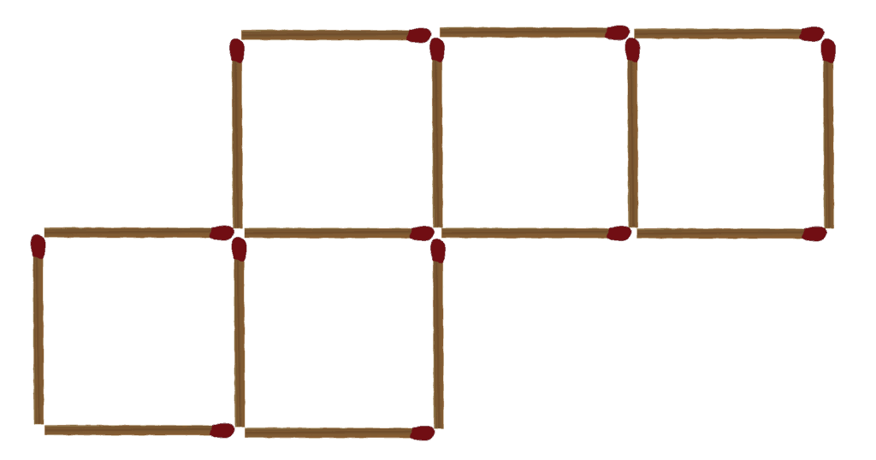
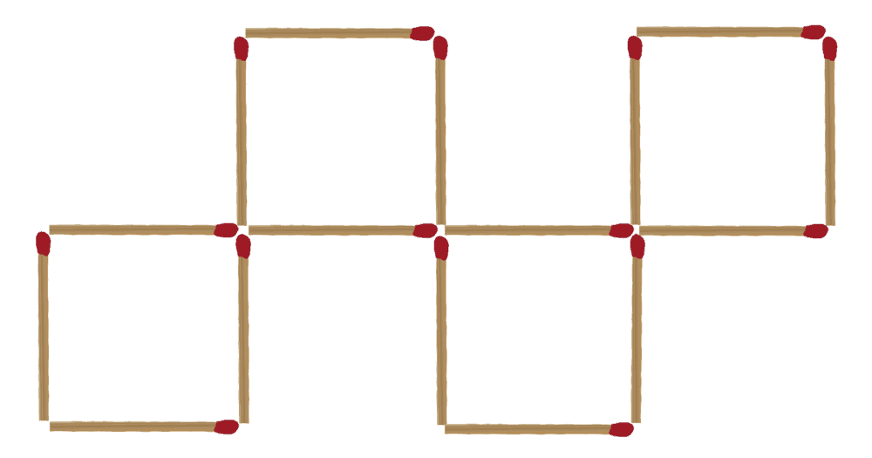
Move 2 matches to make 4 identical squares. There should be no spare matchsticks
22
Hint 1
The two matchsticks come from 2 different squares.
Hint 2
The squares should only be touching by corners.
Solution

Slide 24
23
Hint 1
The pyramid finishes a row lower
Hint 2
8 and 9 do not move.
Solution

Slide 25
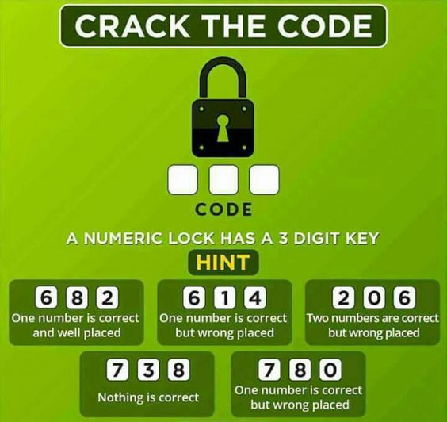
24
Hint 1
This is easier with pen and paper
Hint 2
6 is not one of the numbers.
Solution
042
1 Can only be 2 0r 6 as 4 tell us its not 8.
2 tell us that its not 6 if not it would be correct and well placed to match 1
3+5 tells us 0 is right but in the wrong place
2 tells us 4 is the final number

Slide 26
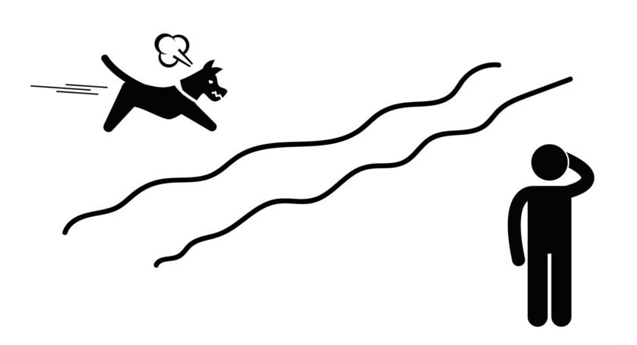
A man is standing on one side of a river. He calls his dog who runs across the river straight to him. How?
25
The dog is a normal dog.
Hint 1
Hint 2
The dog is running to get warm
Solution
The lake has frozen over.

Slide 27
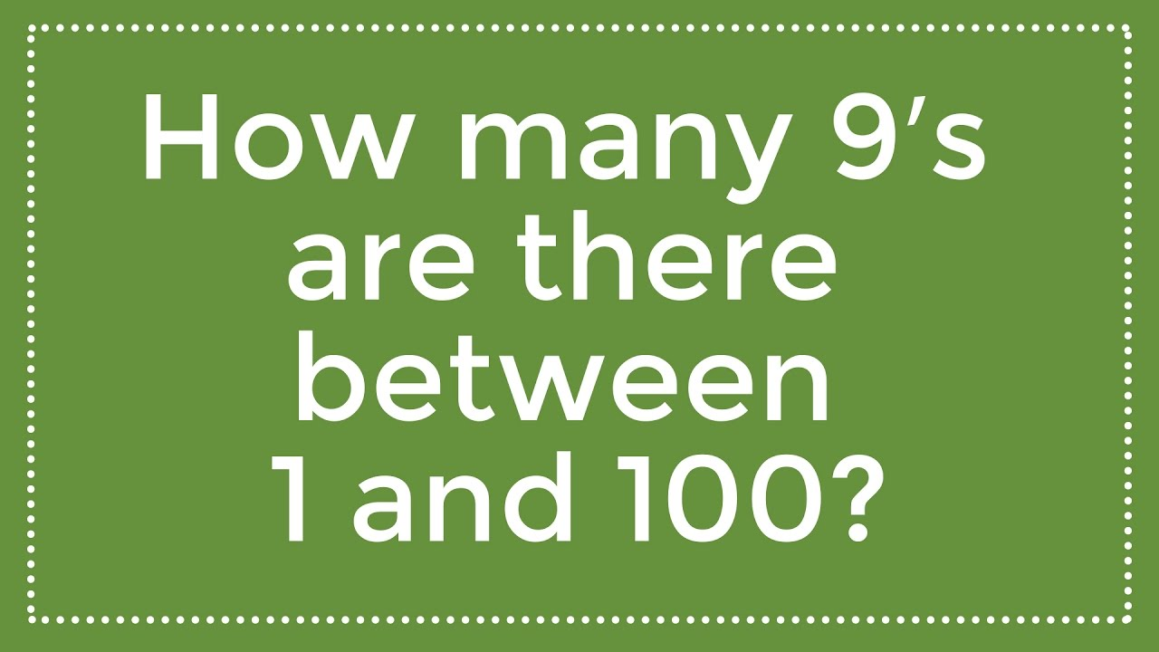
26
Double check your counting
Hint 1
No more hints for this one
Hint 2
Solution
19
09,19,29,39,49,
59,69,79,89,90,
91,92,93,94,95
96,97,98,99

Slide 28
A sundial has the fewest moving pieces for a timepiece. What has the most?
27
You can make this timepiece yourself
Hint 1
It is not mechanical in anyway
Hint 2
Solution
Hour glass.
Has thousands of pieces of sand.

Slide 29
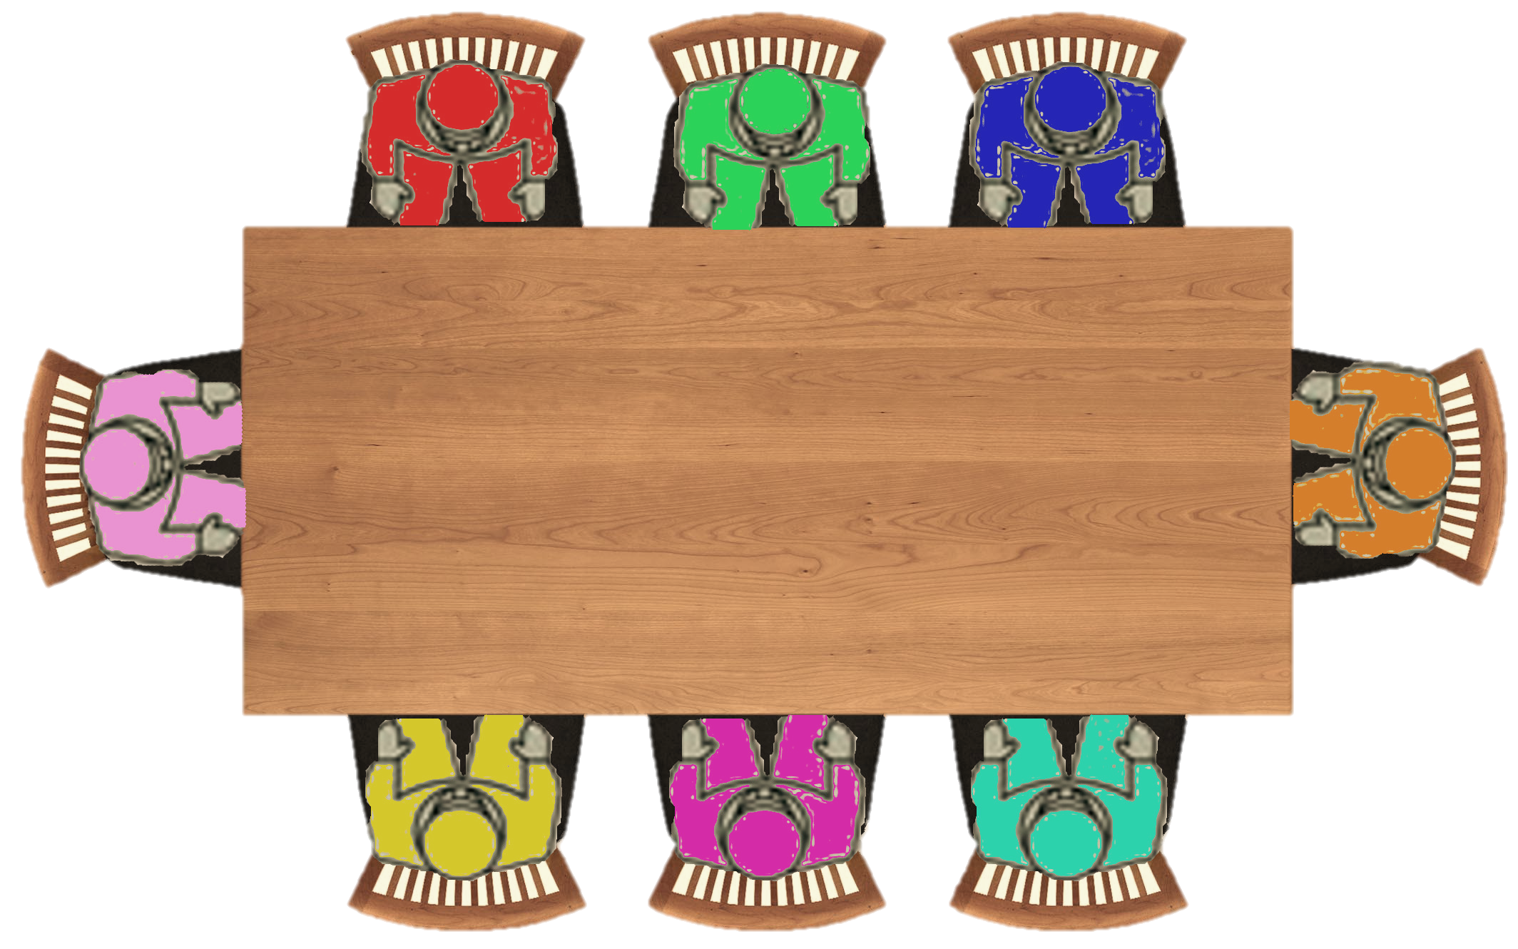
28
Corner seat
Corner seat
Hint 1
Use a pen and paper
Hint 2
There are 4 solutions to this puzzle
Corner seat
Corner seat
They are not in the right place, help them fix it.
Mr. Red wants to sit at a corner.
Mr. Green wants to face Mr. Red
Mr. Blue wants to have Mr. Orange as an immediate neighbour
Mr. Pink doesn't want to sit at a corner
Mr. Orange wants to have Mr. Blue as an immediate neighbour and wants to have Mr. Red as an immediate neighbour
Mr. Yellow wants to face Mr. Magenta
Mr. Magenta doesn't want to have Mr. Green as an immediate neighbour
Mr. Cyan wants to face Mr. Blue
Solution on the next slide

Slide 30
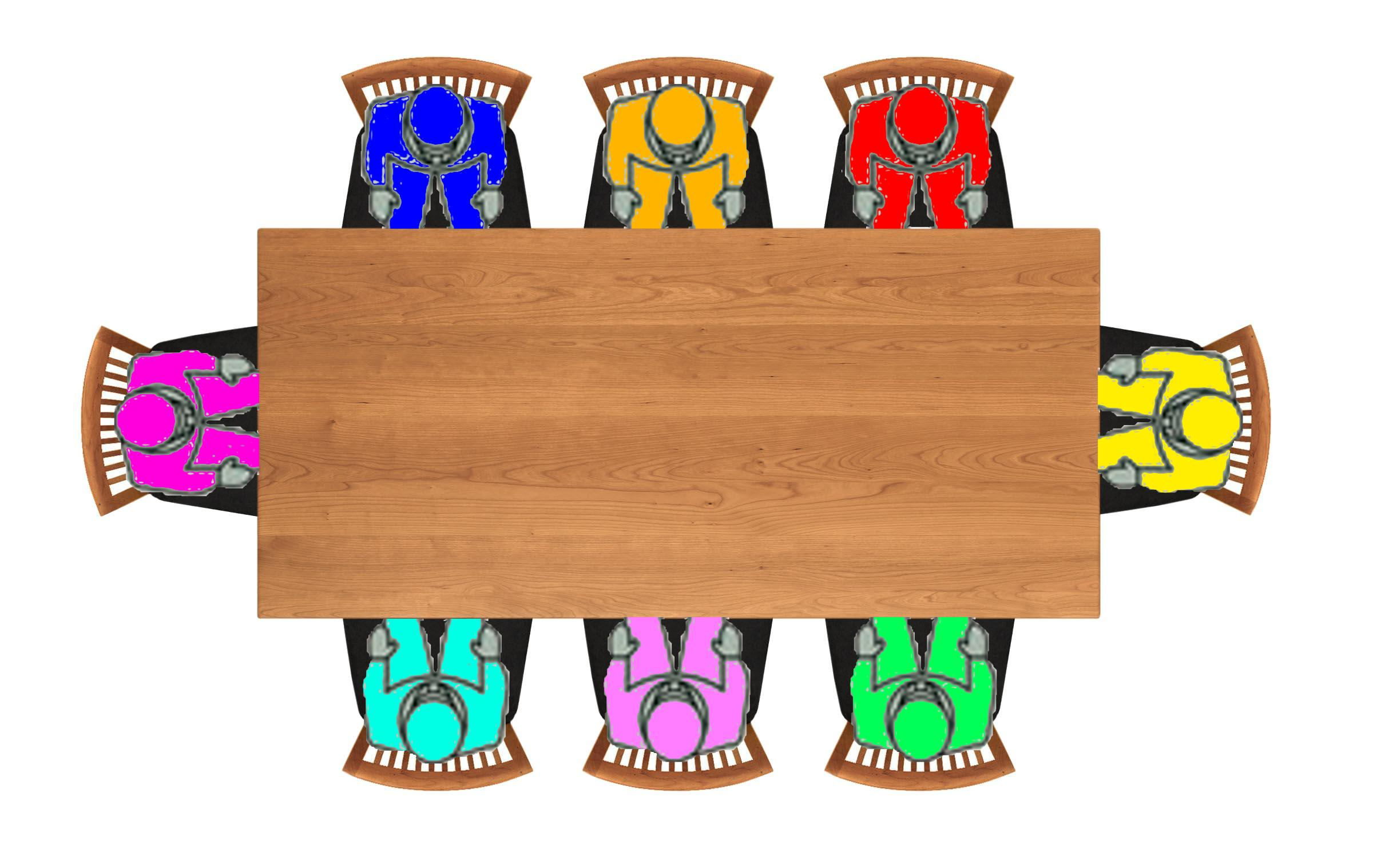
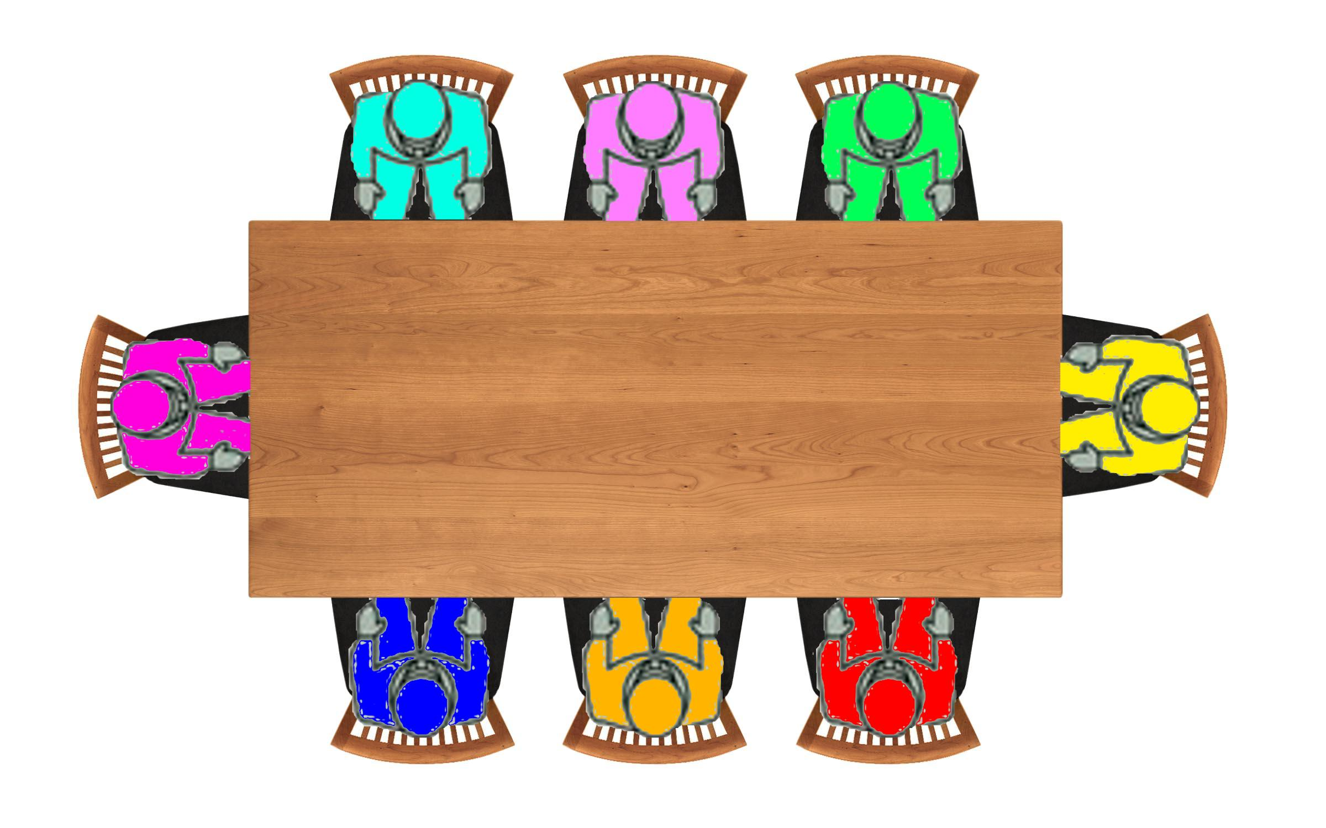
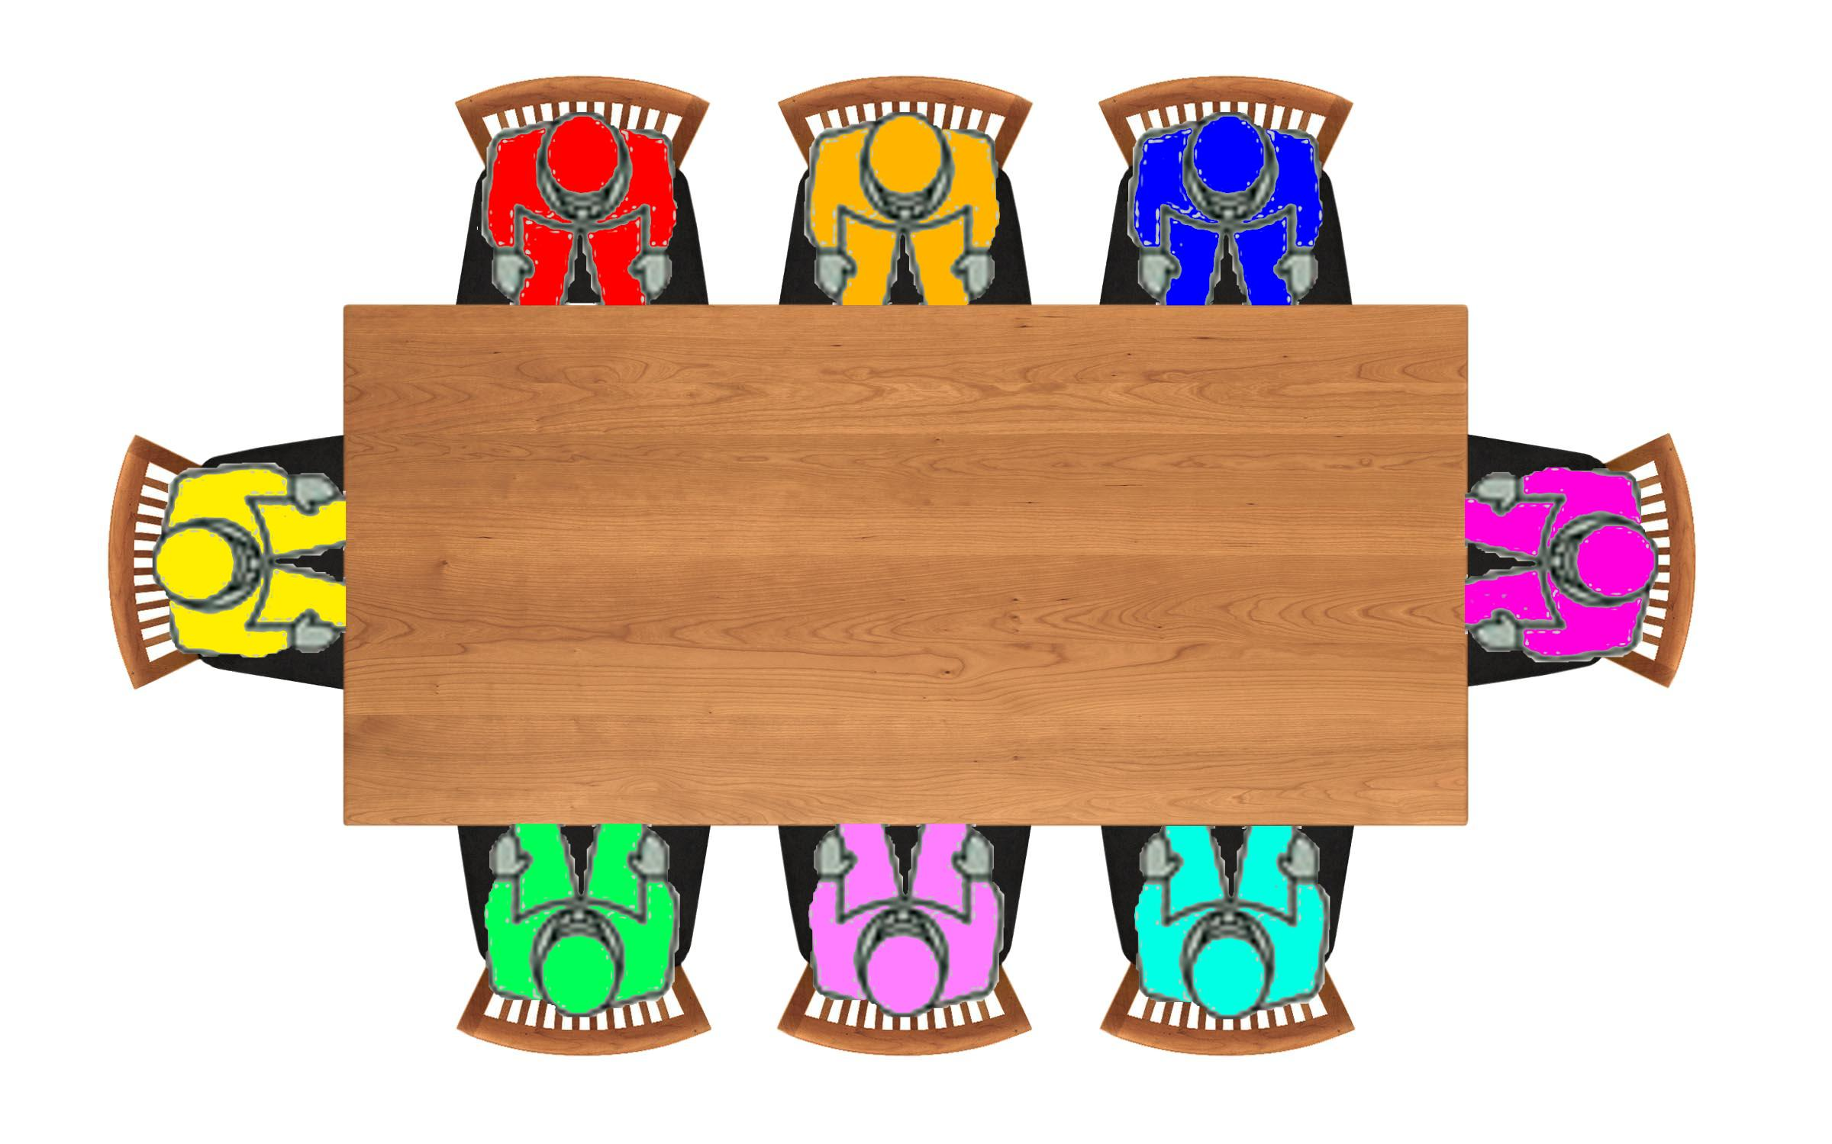
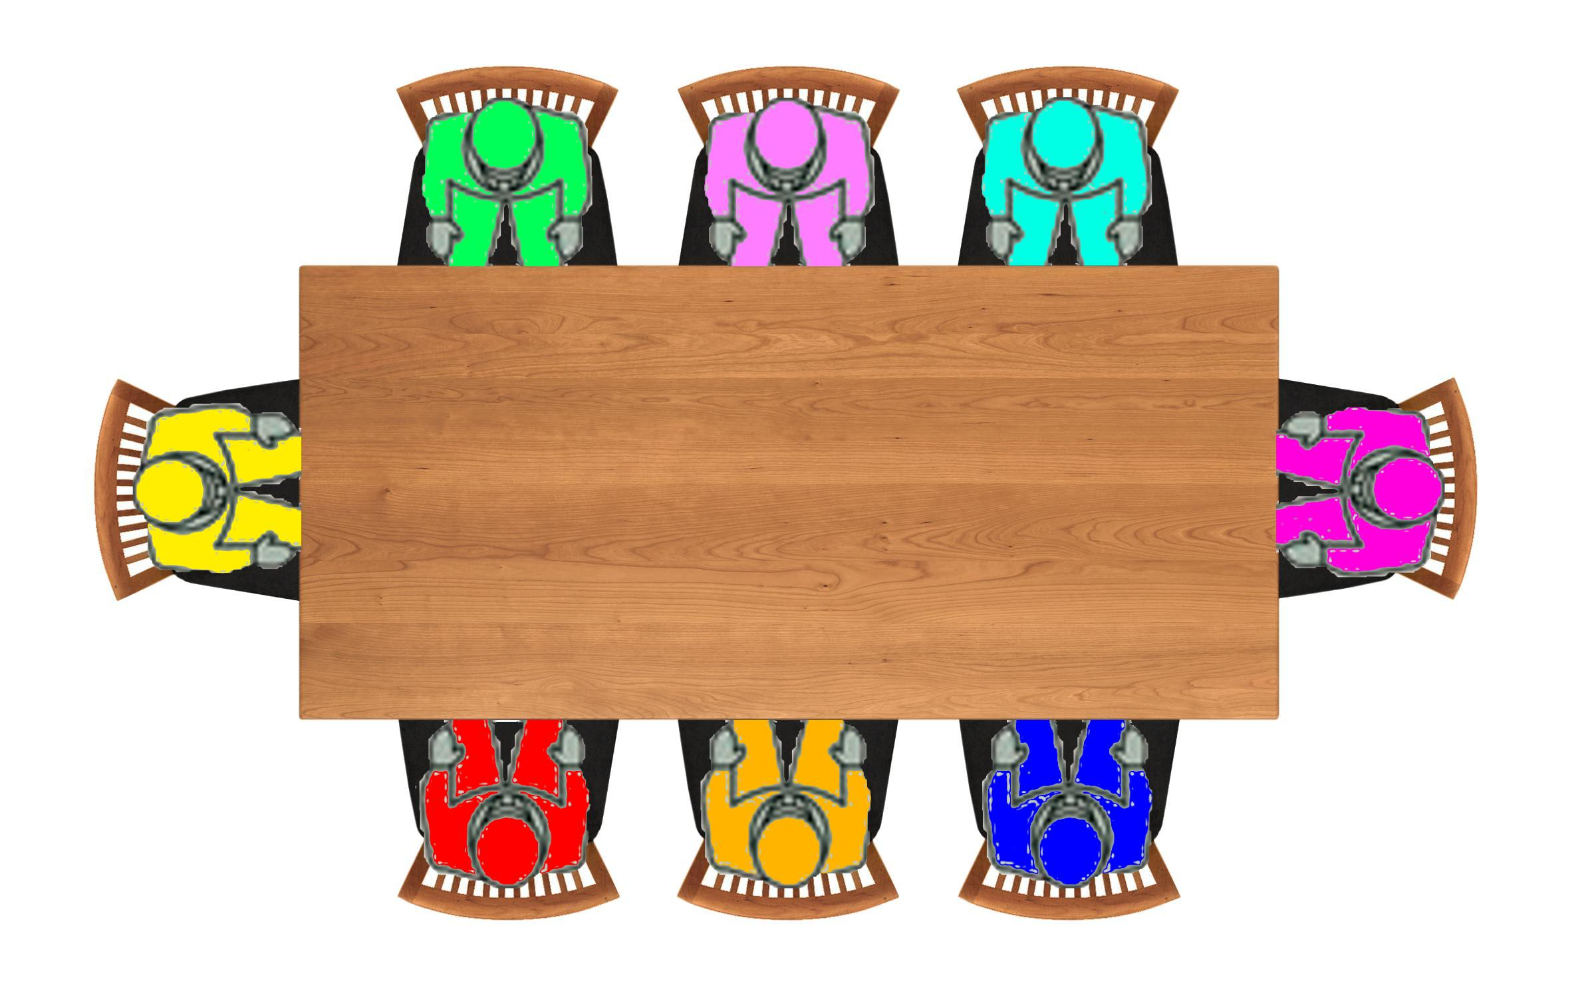
Solution
28
Solution for puzzle 28 only
Puzzle on previous slide.

Slide 31
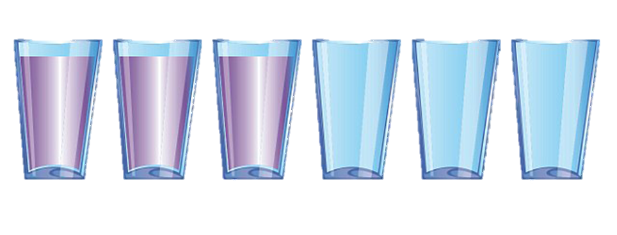
Move only 1 glass to make an alternating pattern
29
Hint 1
The final pattern is FEFEFE
F-Full, E-Empty
Hint 2
You need to move a glass on the left
Solution
Grab the 2nd glass and pour it into the 5th.

Slide 32
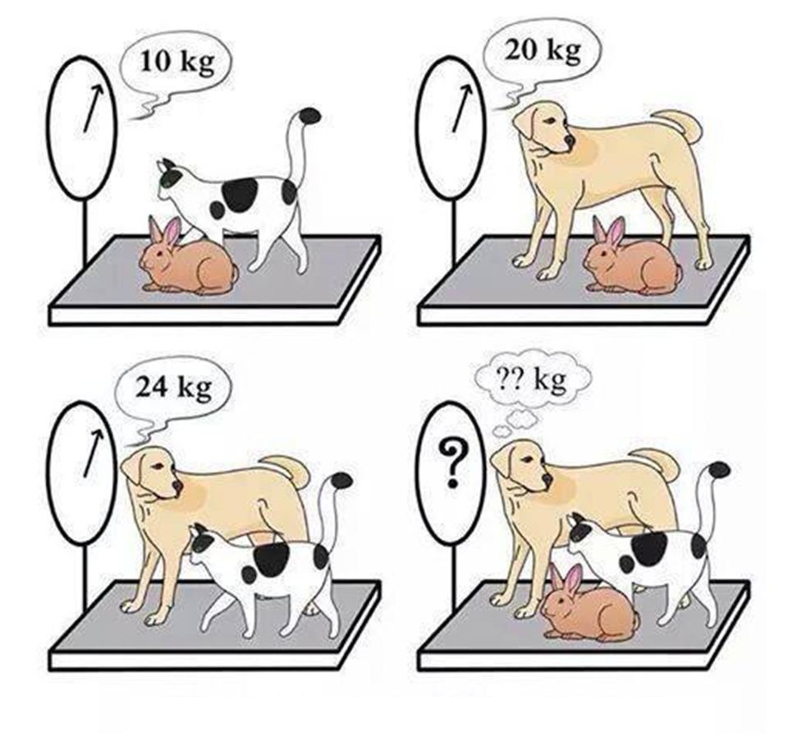
30
Hint 1
The dog is the key to solving this puzzle.
Hint 2
You do not need to work out the weight of all the animals to solve this one.
Answer = 27KG
If we added picture 2 and 3 together, we get the weight of a cat, a rabbit and 2 dogs. (44kg) We know the cat and rabbit weight 10kg. So we can take that away leaving 34kg for 2 dogs. If half that we now know the dog weighs 17kg and we can add the 10kg for the cat and rabbit back.
Solution

Slide 33
31
11 is needed for the solution
Hint 1
All numbers are odd and 3 odds can not make an even number, so you are going to have to get creative.
Hint 2
Solution
11+13+6
You will have to turn the 9 upside down.

Slide 34
Mike, Andrew, Kevin and Rory are playing tug of war Mike and Andrew pulled Kevin and Rory easily. After that, both Mike and Kevin together managed to pull Rory and Andrew hardly. Then, both Mike and Rory played against Andrew and Kevin but neither of them won the game. Thus, can you compare them according to their strength?
32
Hint 1
Pen and paper is recommended
Hint 2
Mike + Andrew >> Kevin + Rory
Mike + Kevin >Rory + Andrew
Mike + Rory = Andrew + Kevin
Solution
Mike>Andrew>Kevin>Rory
Part 1 tells us mike and Andrew must be the strongest.
Part 2 tells us Mike is stronger than Andrew or Kevin is stronger than Rory
Part 3 confirms that both parts of part 2 are true.

Slide 35
How many moves will it take to transfer the balls to tube 3 and keep them in order. You can only move 1 ball at a time. Must not have a ball on top of it A ball can go to any tube
33
Hint 1
It can be done in less than 8 moves
Hint 2
It can be done in exactly 6 moves… How?
Transfer the 3rd ball from 1st tube to 2nd tube
Transfer the 2nd ball from 1st tube to 2nd tube
Transfer the 1st ball from 1st tube to 3rd tube
Transfer the 2nd ball from 2nd tube to 3rd tube
Transfer the 3rd ball from 2nd tube to 3rd tube
Solution

Slide 36
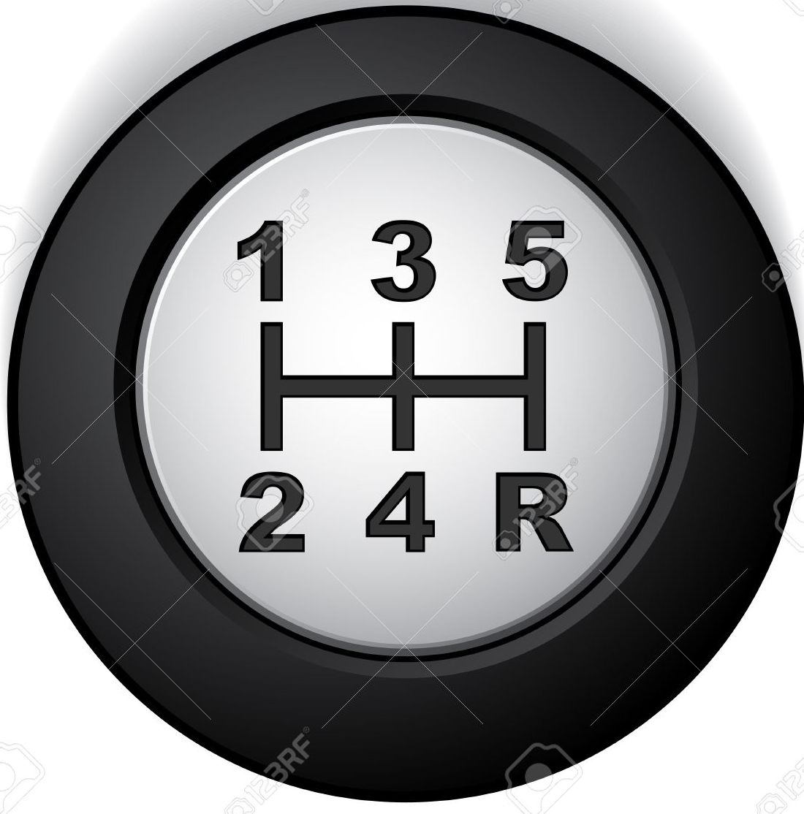
1 3 5 2 4 ?
34
Hint 1
The answer is not a number.
Hint 2
Forward thinking is not going to help here.
Solution
R
The answer is not 6.

Slide 37
35
It has been raining
Hint 1
The houses do not matter
Hint 2
Bob is lying. There is a puddle on his car which means he has moved his car while he has committed the theft.
Solution

Slide 38
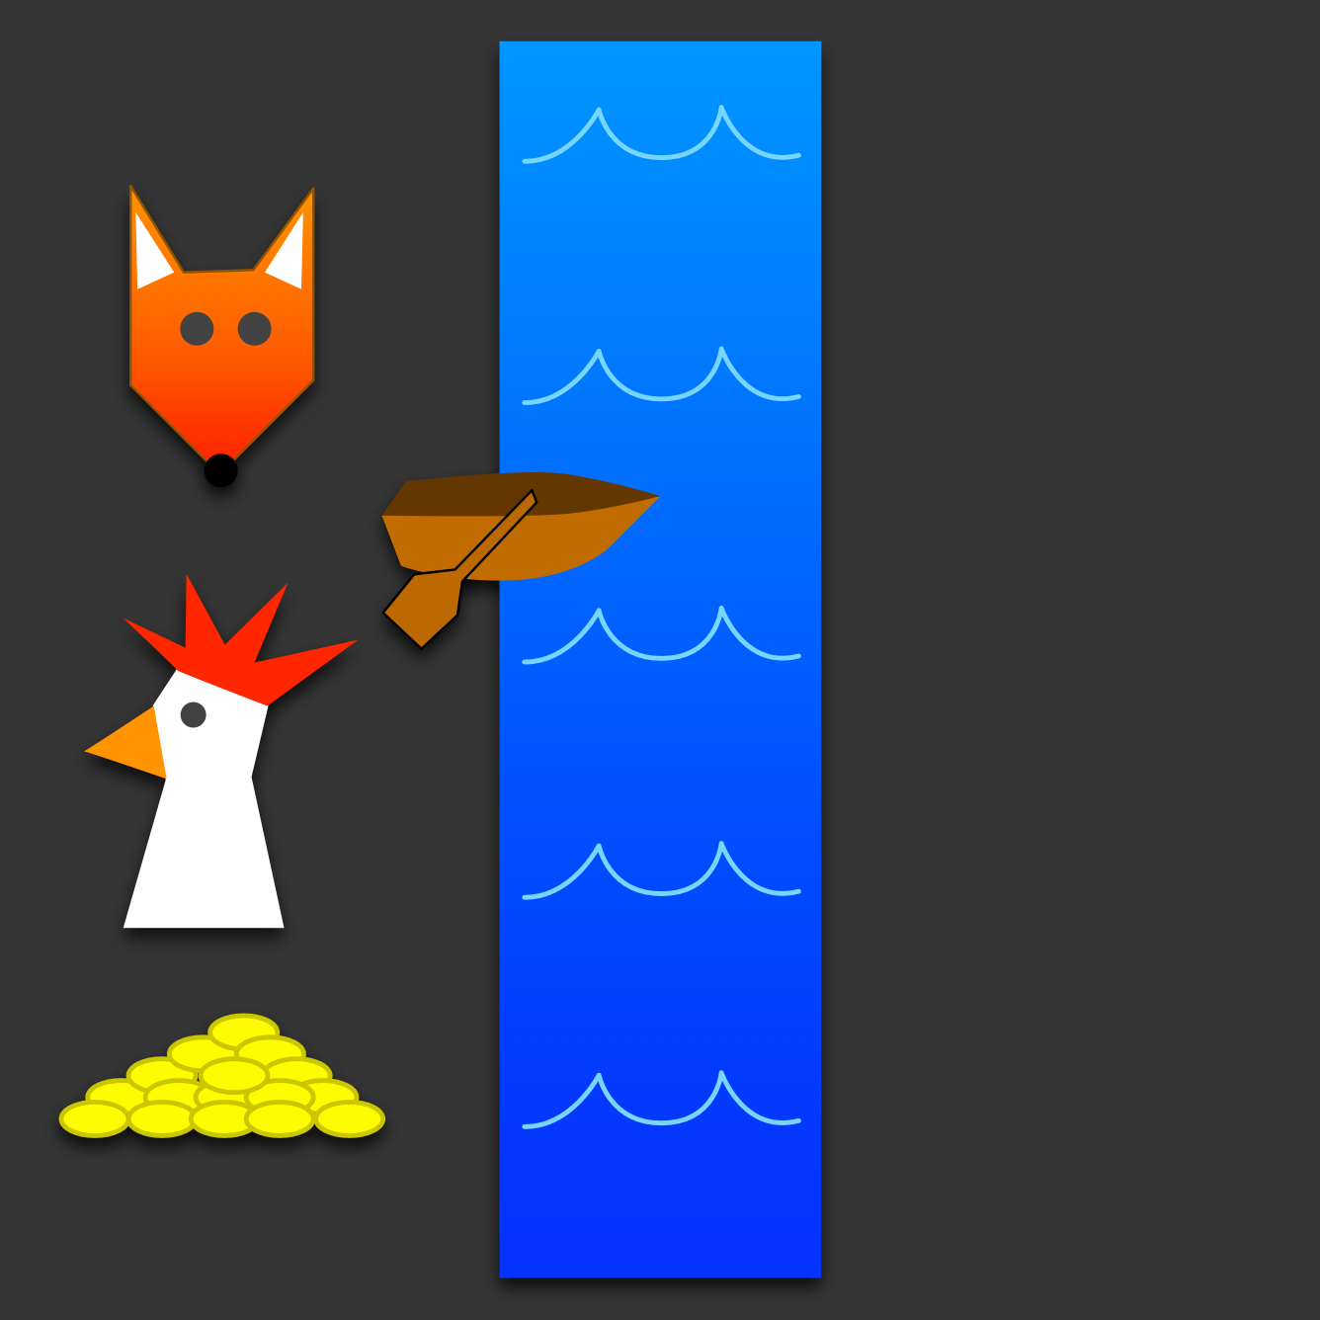
A farmer must get a fox, a chicken and seeds across a river The fox will eat the chicken if they are left alone The chicken will eat the seeds if left alone The farmer can only take one at a time.
36
Hint 1
The fox and chicken are not alone if the farmer is there
Hint 2
You need to make 7 trips
Solution
1.Take the chicken
2.Return to the other side
3.Take the fox
4.Return the chicken
5.Take the seeds
6.Return for the chicken
7.Bring the chicken across

Slide 39
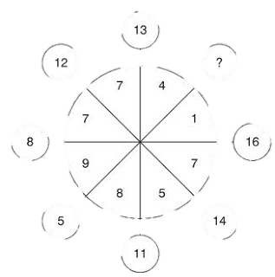
37
Hint 1
Continue the lines to hit the outside circles
Hint 2
The two numbers closest to the question mark will not help you.
Solution
Answer = 17
Add opposites segments together

Slide 40
What is the hidden word?
38
Hint 1
Look at how the words are positioned
Hint 2
No more hints for this one
Solution
Top Secret

Slide 41
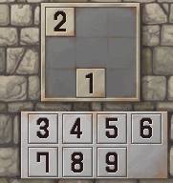
Add the remaining numbers so that each row, column and diagonal all equal the same value.
39
Hint 1
All rows, columns and diagonal = 15
Hint 2
There is a 5 in the centre square.
Solution

Slide 42
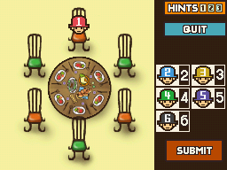
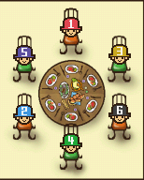
Six brothers have gathered around a table to eat dinner. Each or the brothers is prone to fighting with the siblings directly above and below him in age and can't be seated next to either of them. Also, Brothers 3 and 5 got into an argument the other day and refuse to sit next to each other. The eldest brother (Brother 1) has already sat down at the big table and is waiting on the others to start eating. Can you find a seating arrangement that will keep everyone from fighting with each other?
40
Hint 1
Use pen and paper to make it easier
Hint 2
Sit brother 3 next to 1
Solution

Slide 43
What is the hidden word?
41
Hint 1
Its not a square it’s a box
Hint 2
No more hints for this one
Solution
Think outside the box

Slide 44
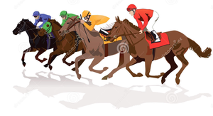
There are 3 racehorse *one can do 4 laps a minute *Another 3 laps a minute *And the last 2 laps a minute If they are set off at the same time, when will they all line up again on the track.
42
They answer is not 12
Hint 1
Reread how fast each horse can go
Hint 2
Answer = 1
All horse can do x number of laps per minute. So after a minute they all meet back at the start
Solution

Slide 45
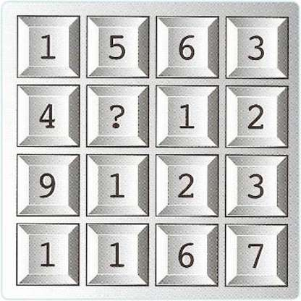
43
Diagonals makes mean nothing
Hint 1
You are looking for a total
Hint 2
Solution
Answer = 8
All rows and columns = 15

Slide 46
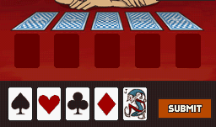
You've placed on joker and four aces with different suits facedown on a table. Use the hints below to determine the position for each card. . The club is to the immediate right of the heart. . Neither the diamond nor the joker is next to the spade. . Neither the joker nor the diamond is next to the club. . Neither the diamond nor the spade is next to the heart.
44
Hint 1
The heart is not the far right card
Hint 2
The far right cards is the spade
Solution

