Slide 1
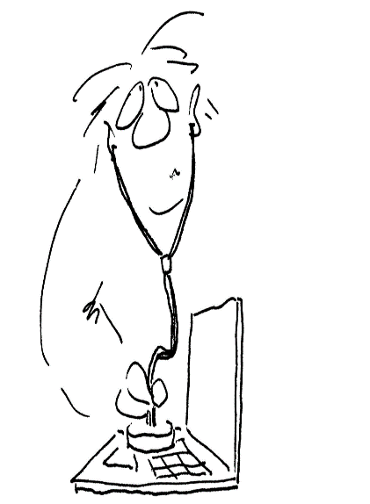
“Informatics” as a Subject(area) in Austrian Primary Education
Introduction
Big Picture
Present Developments
Challenges
Checking the Austrian IT-Fitness of Schools …
01000111 01111001 01101101 01101110 01000010 11100110 11010010 11101010 11011010 01000000 10101101 10000111 01101100 11011000 11010110 11001010 11100100 11011010 11000010 11100100 11010110 1110100
peter.micheuz@aau.at

Slide 2
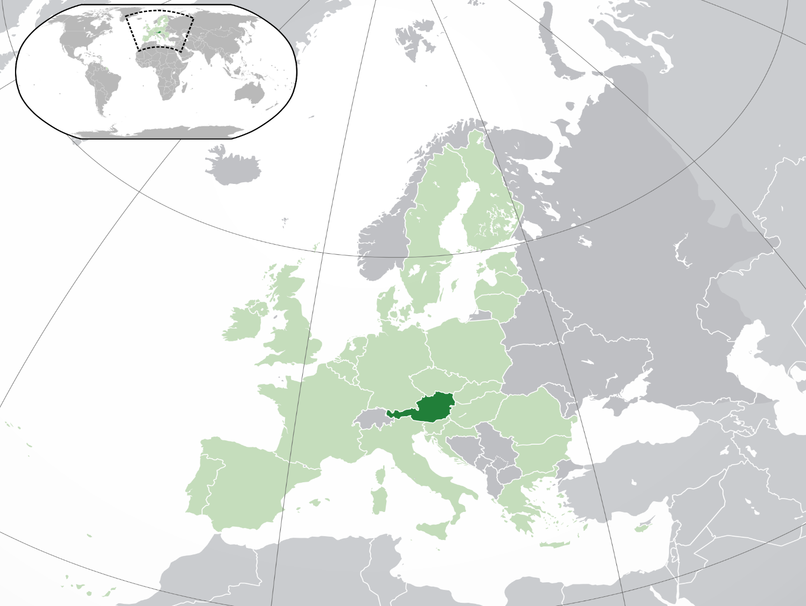
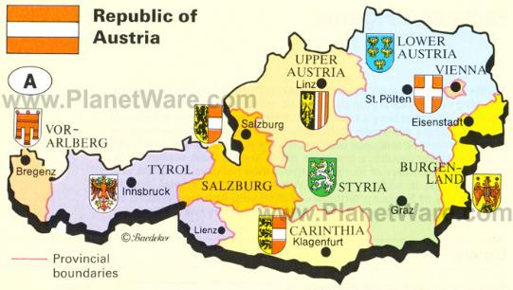
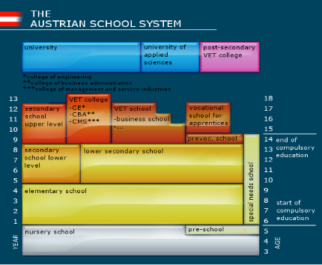
Austria
~ 9 Mill. inhabitants
~ 1,1 Mill. Pupils
~ 120.000 teachers
General Education Primary (6/7 – 10/11) – 350.000 Pupils Lower Secondary (10/11 – 14/15)

Slide 3
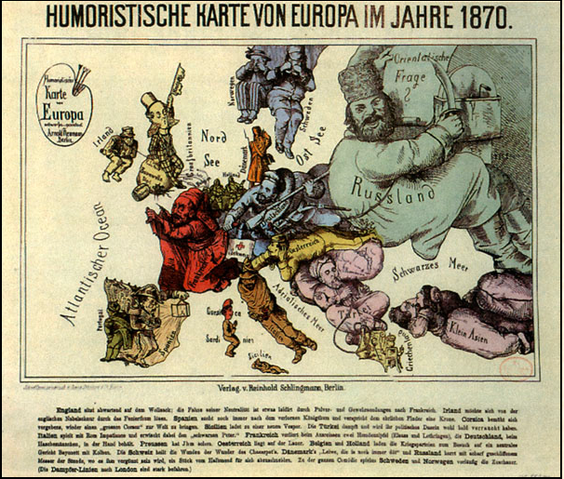
“Austria was/is lying in wait …”
Quelle: »Humoristische Karte von Europa entworfen und gezeichnet von Arnold Neumann, Berlin

Slide 4
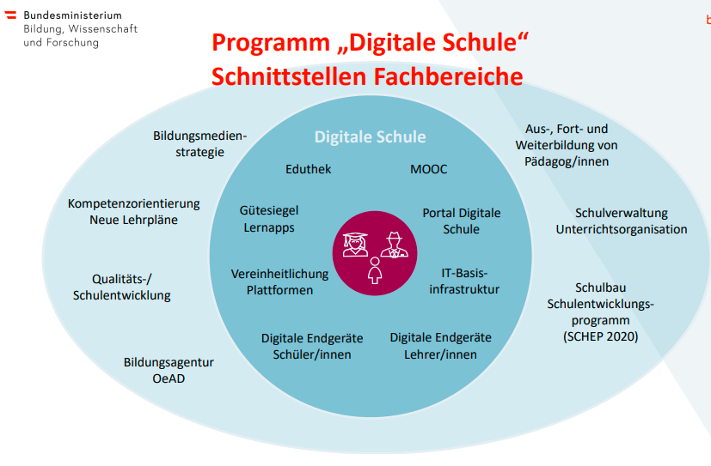
BIG PICTURE
8-points-plan till 2024
new curricula
devices for all pupils in lower secondary
I realize very much ACTION in Austria …

Slide 5
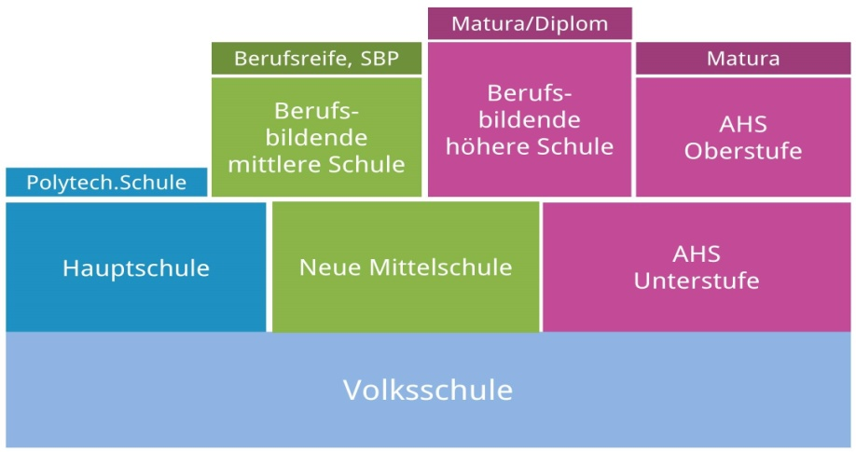
„Informatics“ in a stratified Austrian school system
Upper Secondary Education Vocational Schools
Grammar School
well structured and competence-oriented, detailed curriculum application based
15-18/19 years
Elective 10-12 grades
Upper secondary Grammar School
current focus
Mandatory Informatics Informatics(9th grade)
DISTORTIONS, NO SOLID STRUCTURE
Lower Secondary Education (~ 350.000 pupils)
Middle School
Grammar School Lower Secondary
10-14 years
from 2023/2024 on: new curriculum with a new obligatory subject
Primary Education
7-10 years
interventions, some outreach programs, very occasional

Slide 6
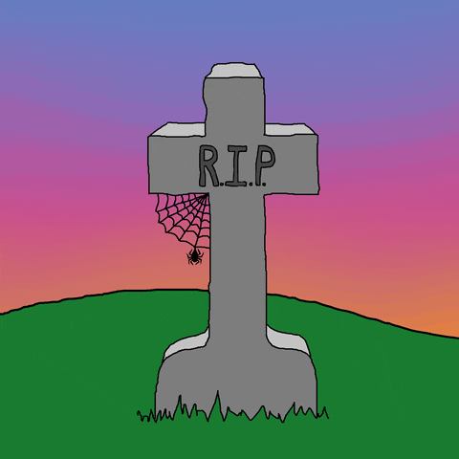
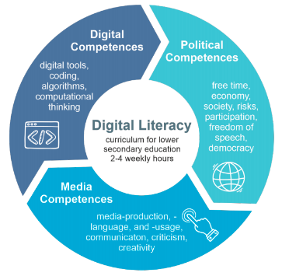
Mandatory Exercise „Basic Digital Education“ 2018/19 – 2022/23
The mandatory exercise „Basic Digital Education“ is implemented by schools in the lower secondary level autonomously.
An enacted curriculum defines the subject matter framework.
Schools decide for themselves whether to teach this subject in special lessons or integrated into other subjects.
Within the scope of two to four hours per week over a period of four years, students acquire competencies in the following areas.
1 Social Aspects of Media Change and Digitization
2 Information-, Data- and Media Competence
3 Operating Systems and Standard Application Software
Basics of Operating Systems
Word Processing Presentation Spreadsheets
4 Media Design
5 Digital Communication and Social Media
6 Security
7 Technical Troubleshooting
8 Computational Thinking
Ca. 100 descriptors

Slide 7
One year ago at OCCE 2021
Speculating about the “big thing“ …
Questions on curriculum issues for Lower Secondary Schools
Including (again?) a new curriculum (still “TOP SECRET“) „Basic Digital Education“ with a new content design?
Will it be still a „Mandatory Exercise“, but no full subject?
When will the review phase start?
Enactment presumably as of schoolyear 2023/2024?

Slide 8
„True facts“ about the “big thing“ …
New curriculum for lower secondary schools
This year at WCCE 2022: Facts
Subject name remains: „Basic Digital Education“ Curriculum with a completely new content design
It is a full subject with at least 1 hour peer week and grade (4 additional !!! hours per week, from 120 -> 124)
Review phase in April 2022 -> minor amendments
Enactment for grades 5-7 as of schoolyear 2022/2023?
Full implementation with all other subjects 2023/2024

Slide 9
CURIOUS FOR MORE? AREN‘T YOU?

Slide 10
I MUST DISAPPOINT YOU ;-(
IT IS NOT PART OF THIS SYMPOSIUM…

Slide 11
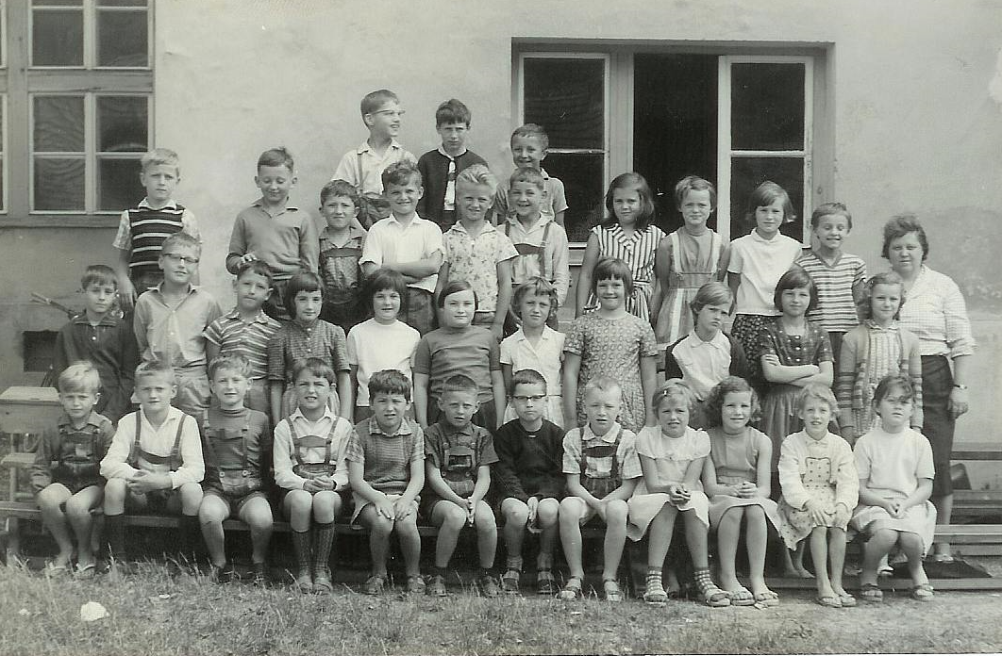
We are talking about 9 years old children …

Slide 12
„Informatics“ in a stratified Austrian school system
Upper Secondary Education Vocational Schools
Grammar School
well structured and competence-oriented, detailed curriculum application based
15-18/19 years
Elective 10-12 grades
Upper secondary Grammar School
Mandatory Informatics Informatics(9th grade)
DISTORTIONS, NO SOLID STRUCTURE
Lower Secondary Education (~ 350.000 pupils)
Middle School
Grammar School Lower Secondary
10-14 years
from 2023/2024 on: new curriculum with a newly designed obligatory subject
Primary Education
7-10 years
new curriculum, projects , interventions, outreach programs

Slide 13
Who wants to build high towers must work well on the foundation.
Anton Bruckner was an Austrian composer and music teacher.

Slide 14
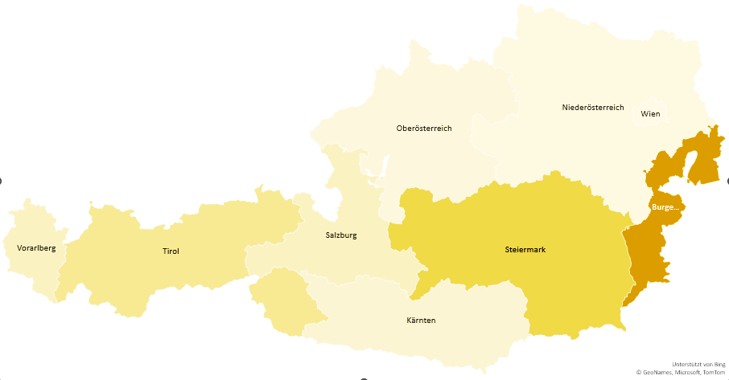
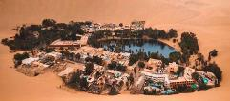
THE NEW BASIC DIGITAL EDUCATION IS ABOUT TO BE IMPLEMENTED UNDER THE NEW CONDITIONS FROM NOW ON.
Lower Secondary Grades 5 – 8 10 – 14 YEARS
Primary Education Grades 1 - 4 6/7 – 10 YEARS
INFORMATICS EDUCATION AS AN OVERARCHING TOPIC FROM 2023/2024 ON.

Slide 15
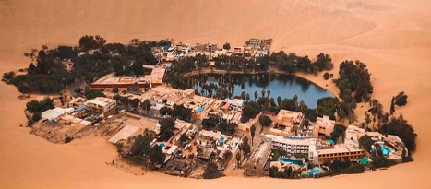
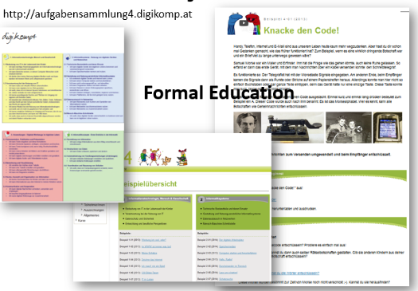
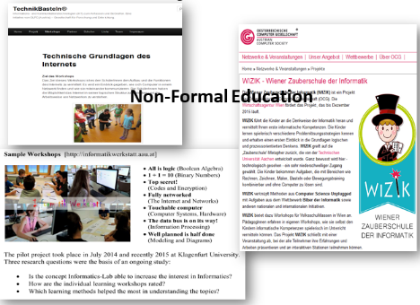
projects and initiatives
Participation rate for the Beaver Contest is low. Only 50 out of 3000 primary schools took part in the BEAVER Contest 2021. 1000 (400 grade 3 / 600 grade 4) out of 350.000 pupils.

Slide 16
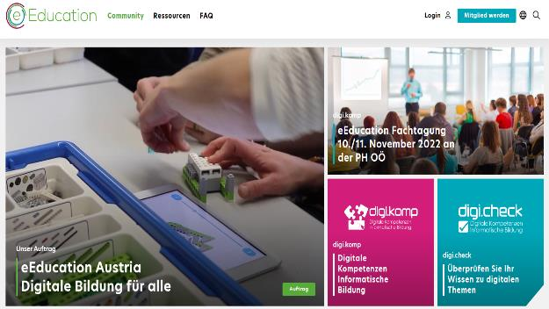
eEducation.at - Initiative Digital Education for All
Impressive figures
„Only“ ~ 4500 activities in primary schools with a very inhomogenious distribution
 | Aktivitäten | Schüler | Quotient
Burgenland | 650 | 10350 | 100
Kärnten | 200 | 20500 | 16
Niederösterreich | 334 | 65000 | 8
Oberösterreich | 405 | 61700 | 10
Salzburg | 292 | 21400 | 22
Steiermark | 1602 | 45000 | 57
Tirol | 658 | 29100 | 36
Vorarlberg | 236 | 16900 | 22
Wien | 361 | 111400 | 5

Slide 17
CURRICULUM ISSUES IN PRIMARY EDUCATION
Central idea: Competence Orientation
- Subject specific competences in the main subjects structured uniformly and contain the respective educational and teaching tasks, the didactic principles, subject-specific competency models competency models and the associated competency areas
- Supra disciplinary (meta-) competences Motivation, self-awareness and confidence in oneself, social skills and learning method competencies
- Interdisciplinary, overaching competences

Slide 18
Searching for (traces of) „INFORMATICS“ in the curriculum
SUBJECTS
OVERLAPPING TOPICS
Educational, Career and Life Orientation
Entrepreneurship Education
Health promotion
Informatics Education
Intercultural Education
Media education
Civic Education
Reflective gender education and equality
Sexual education
Language education and reading
Environmental education for sustainable development
Traffic and mobility education
Economic, financial and consumer education
German
Mathematics
"Sachunterricht"
Technology and Design
Art and Design
Music
Sports

Slide 19
REMARKS ON LEARNING WITH IT Didactic Principle:
Teachers provide digitally supported instruction and use innovative learning and teaching formats.
Some statements from the Curriculum:
Use of media and digital digital devices in the classroom opens up new didactic and methodological possibilities.
Creative exploration of topics and content is possible.
Communication, collaboration, and access to up-to-date information and diverse learning materials can take place independently of time and place.
Contemporary teaching and learning requires digitally supported teaching.
Teachers use learning management systems and learning platforms for innovative teaching and learning formats.

Slide 20
Overarching topic: Informatics education (“Informatische Bildung”)
Significance and rationale
[...]
The teaching of computer literacy
should be carried out using everyday language,
but also by using the (formalized) subject language.
also by using (formalized) technical language.
The short half-lives of technical development mean that it is not the operation of current hardware and software that constitutes informatics education,
but the understanding of the principles and the basic technologies.

Slide 21
Competence goals at the end of primary school
(All) Pupils will be (hopefully) able to
- use information technologies in a safety-conscious and responsible manner.
- understand simple instructions, carry them out and create instructions themselves.
- use digital devices and the Internet for learning.
- create and design digital drawings and images.
- experience self-efficacy by using digital technologies creatively and in a variety of ways.

Slide 22
“SACHUNTERRICHT” encompasses areas of social - historical - political - geographic economic - physical - chemical technical - biological - ecological aspects of the world. central subject for dealing with interdisciplinary topics

Slide 23
Exemplary competence descriptions in the “Technical competence area”: The pupils can
- recognize and describe the importance of technical aids
- operate digital media appropriately and use them in a topic-related manner.
- reflect on their own use of and experiences with digital media.
- Media and communication e.g. protection and safety when using digital media (cell phone, tablet, computer), observe, describe, document.
Grade 3 (9 years)
- deal with technical problems, try out model solutions and justify them.
justify them; program simple instructions for action.
- Recognize phenomena and things in nature as models for technical developments, derive and justify them.
- assess the significance, changes and consequences of technical developments for humans and the environment.
- apply automated processing, storage and communication of information.

Slide 24
Great challenges …
The long way from the “paper” into the brains of teachers and pupils
the learners, the teachers (education)
facilities, school environment, culture and ideology, instructional supervision, and assessment …
… and textbooks and other resource materials
Next slide: Just one little thing as a virtual take away …

Slide 25
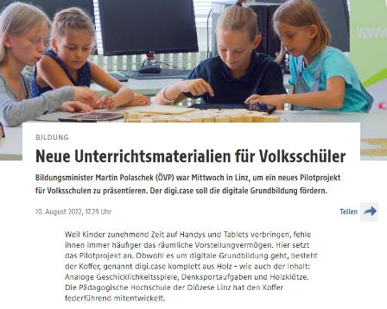
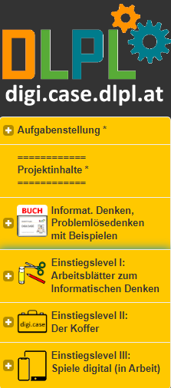
teaching materials for computational thinking…
starting in 100 primary schools
digi.case

Slide 26
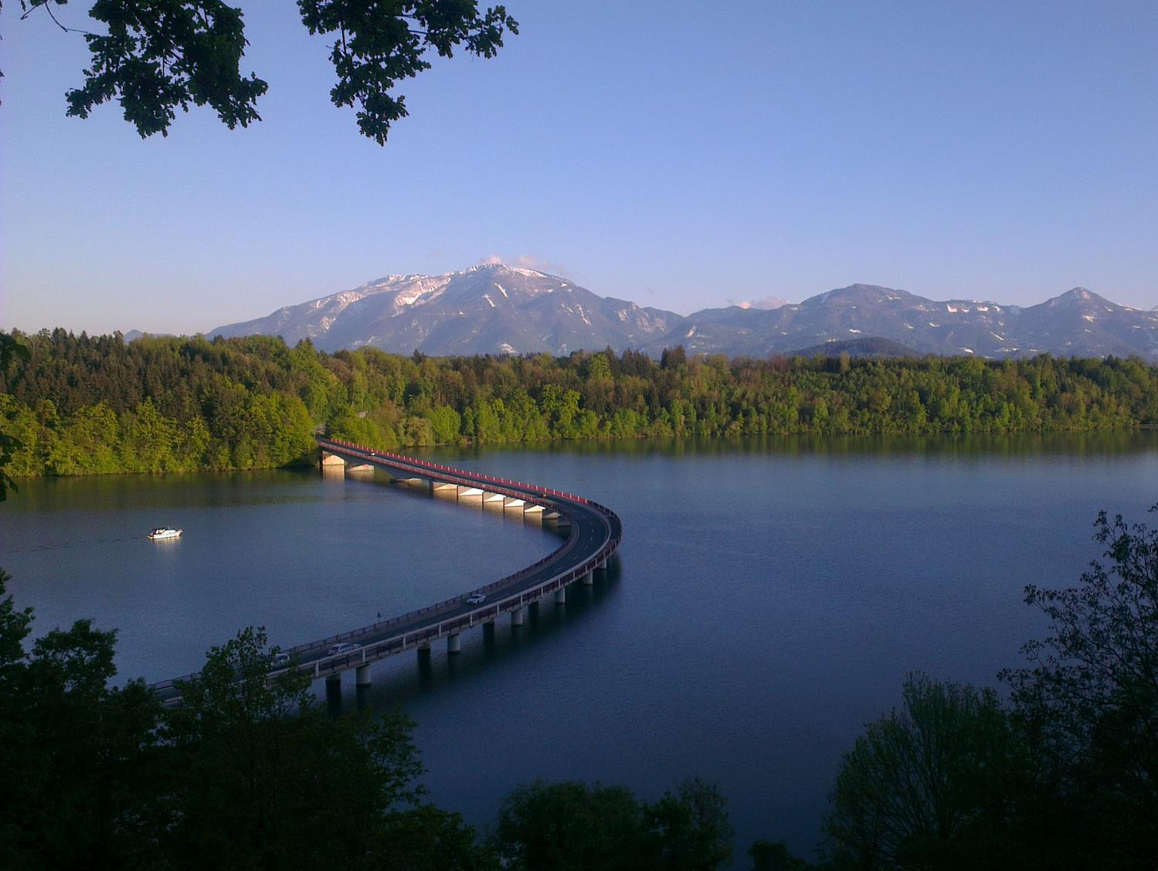
No question, but a big request …
not a big thing ;-)

Slide 27
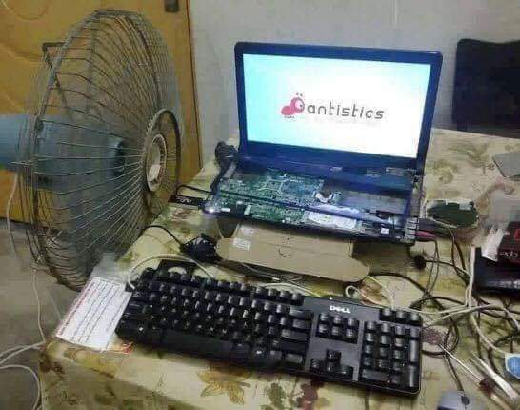
Who will buy me a new computer ;-)

