Slide 1
Facts, Figures, Remarks and Conclusions about the Austrian Bebras Challenge with Regard to Computational Thinking and Computer Science Domains
Peter Micheuz Stefan Pasterk Andreas Bollin
Alpen-Adria-University - Klagenfurt - Austria

Slide 2
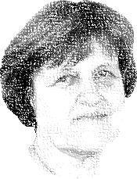
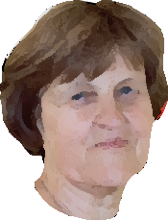
Let‘s see what the guys from Austria have to tell us …

Slide 3
Absolutely no idea! And there is no WIFI!
How many beaver participants in how many countries took part in the beaver contests 2016/17/18?

Slide 4
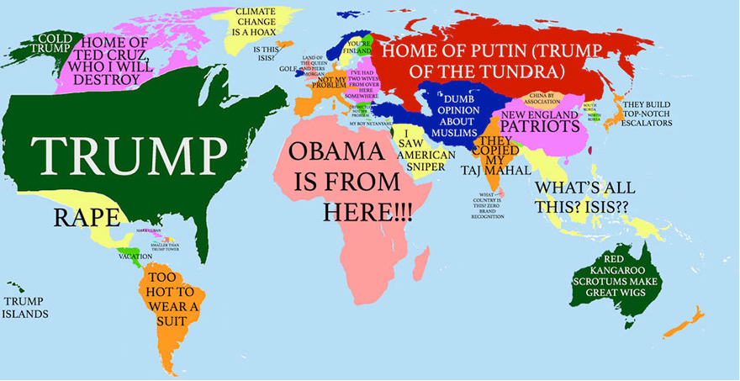
54 countries
~ 2.780.000 pupils
worldwide!
Source: https://www.boredpanda.com/donald-trump-world-map

Slide 5
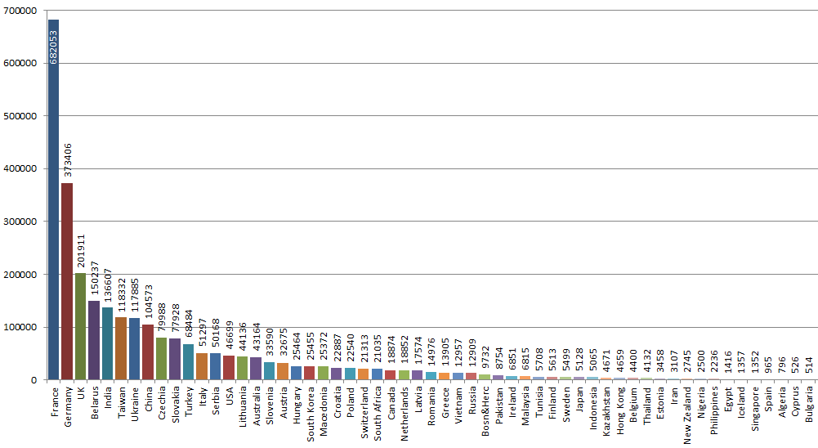
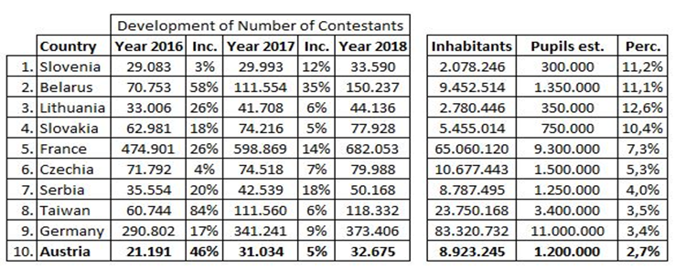
2018

Slide 6
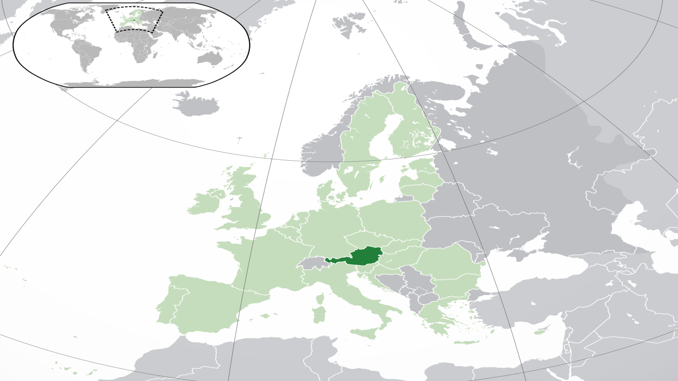
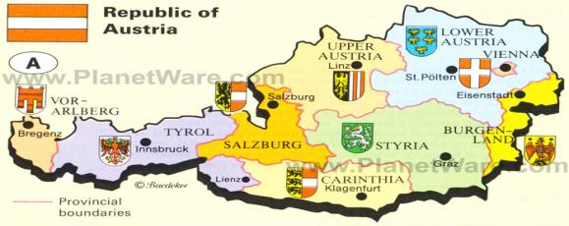
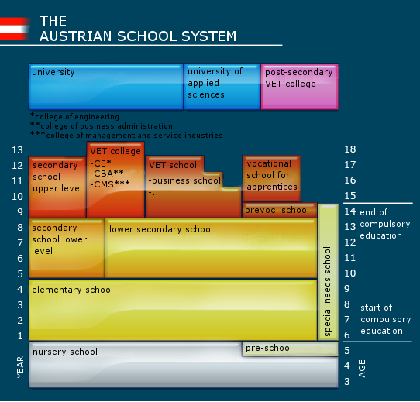
Computational Thinking in the Austrian School System
8,8 Mill. inhabitants
1,13 Mill. pupils
125.000 teachers
General Education at Lower Secondary Till now: One competence model, hundreds of curricula …
Peter Micheuz

Slide 7
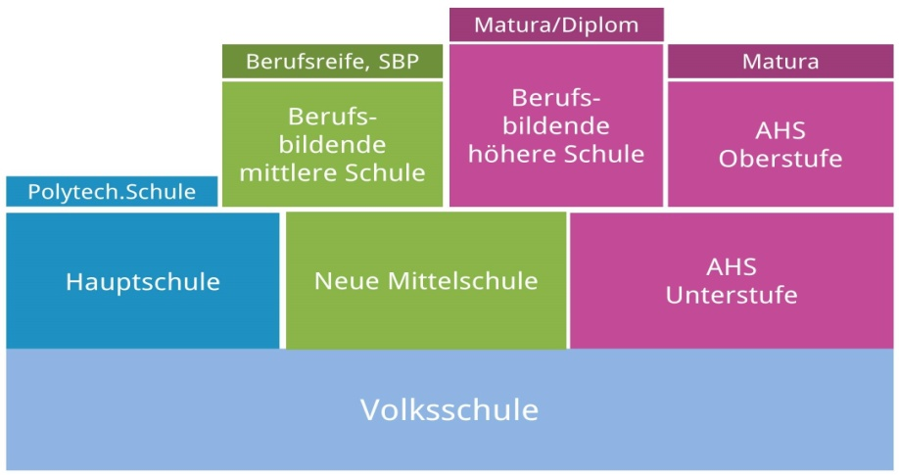
Digital Education in general in a stratified school system
Upper Secondary Education Vocational Schools
Gymnasium
well structured and competence-oriented, detailed curriculum application based
15-18/19
Elective 10-12 grades
Obligatory (9th grade)
DISTORTIONS, NO SOLID CONSTRUCTION
LOWER SECONDARY EDUCATION
10-14
top down recommendation, low commitment
diverse, autonomous
Primary Education
7-10
interventions, some outreach programs , very occasional

Slide 8
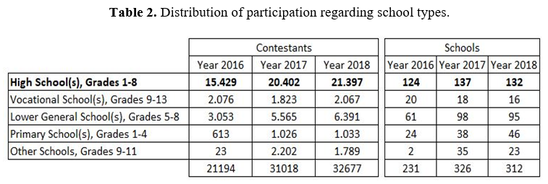
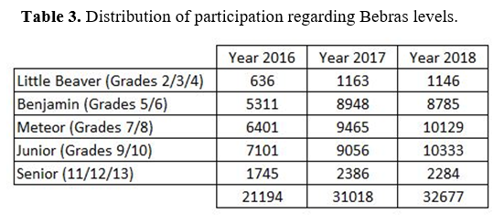
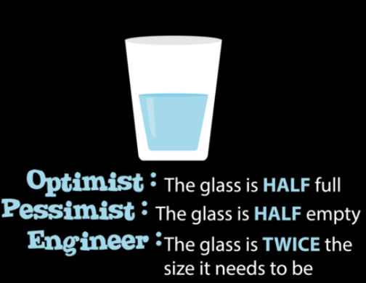
Figures from Austria

Slide 9
I like bebras
I hate these tasks because I have to think

Slide 10
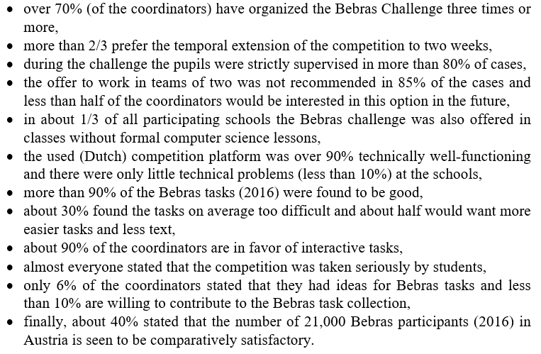
Exemplary Results of a Survey among School Coordinators (2016)

Slide 11
CT

Slide 12
for Digital Education?
“[…] are the thought processes involved in formulating a problem and expressing its solution(s) in such a way that a computer – human or machine – can effectively carry out”.

Slide 13
One remark on Bebras Tasks < > Computational Thinking
„CT is the mental skills and practices
for designing computations that get computers to do jobs for us and
explaining and interpreting the world as a complex of information processes.“.
Distinction between „CT for beginners“ (K-12 education) and „CT for professionals“ (rich skillset with six dimensions: machines, methods, computing education, software engineering, design, and computational science)
„If you try to understand what Computational Thinking is from media accounts (and many publications) you will hear a story of problem solving with algorithms, along with the ability to think at the many levels of abstraction needed to solve problems. But the K-12 education insights and debates barely scratch the surface of CT” [Denning/Tedre]
Standpoint:
If we agree on CT as a set of trained and broad skills and look at the assertion that Bebras tasks can be solved at every level without prior Informatics education, we should see the Bebras challenge less as a role model for CT, but more as a valuable initiative for transmitting many Informatics concepts.

Slide 14
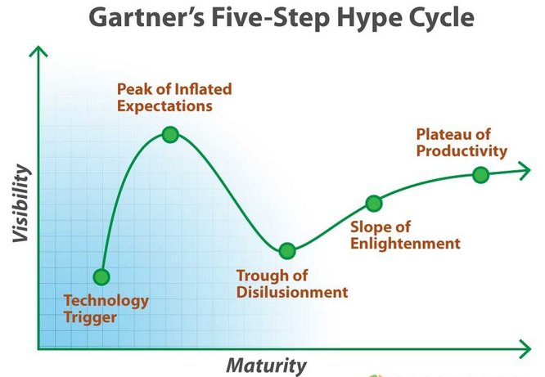
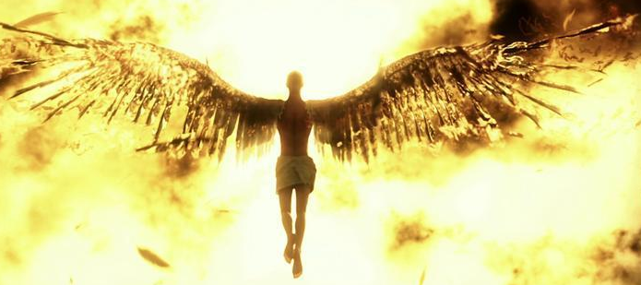
Development of Computational Thinking
Logical and Algorithmic Thinking, Decomposition, Generalization, Pattern Recognition, Modelling, Abstraction

Slide 15
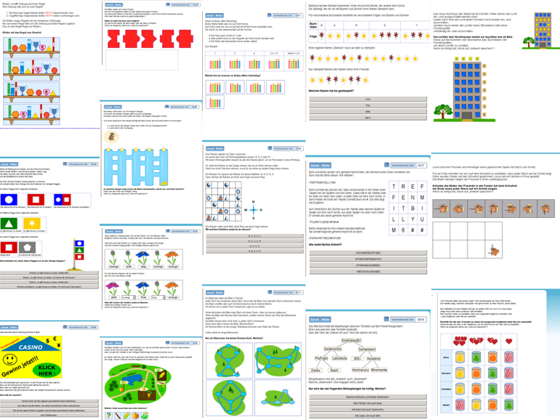
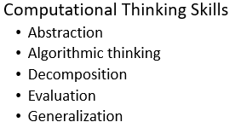
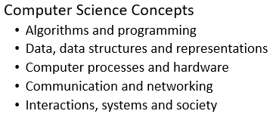
Categorising (Austrian) Bebras Tasks

Slide 16
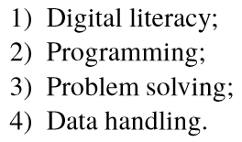
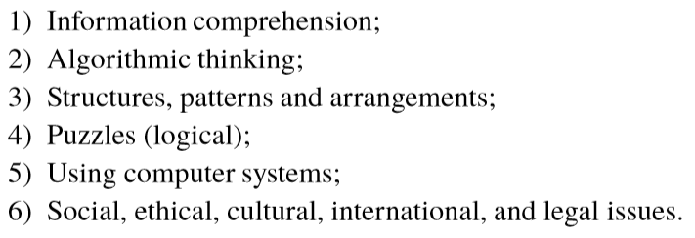
Dagienė V., Sentence S., Stupuriene G.: Developing a Two-Dimensional Categorization System for Educational Tasks in Informatics. Informatica, Lith. Acad. Sci. 28, 23-44, (2017).
Revised 2008
Futschek, Dagiene
Kalaš, Tomcsányiová 2009
First categorization 2006 Opmanis et al.

Slide 17
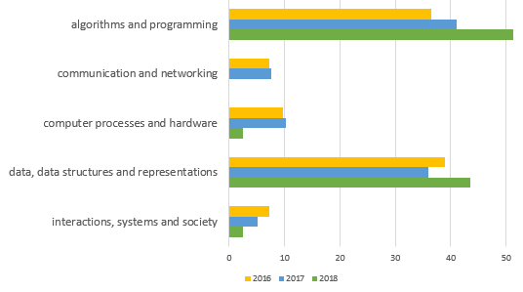
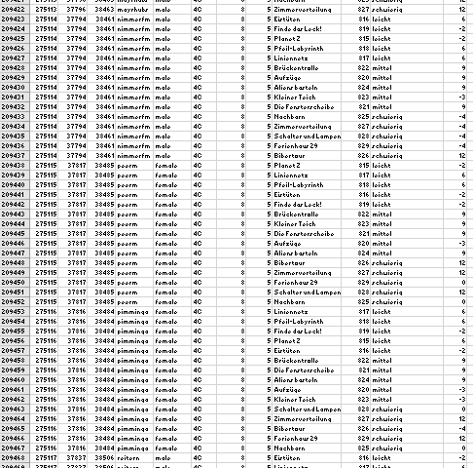
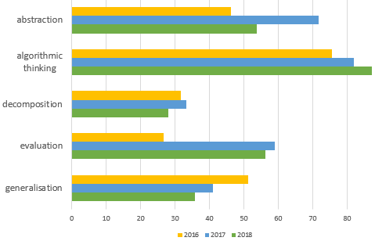
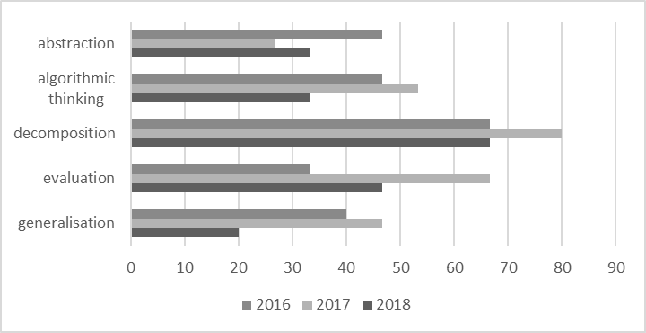
data, data, data, …
~ 450.000 rows
(for year 2018)
Anomaly in 5/6 grades

Slide 18
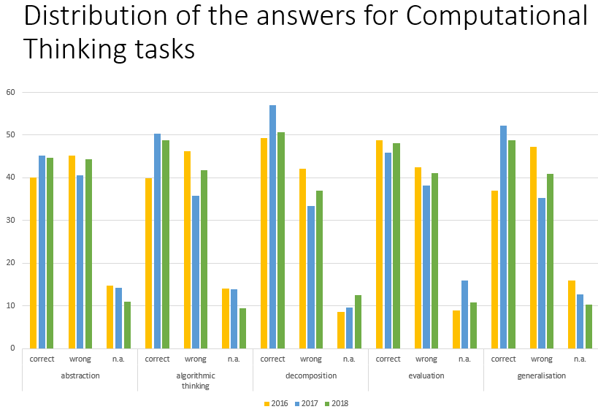
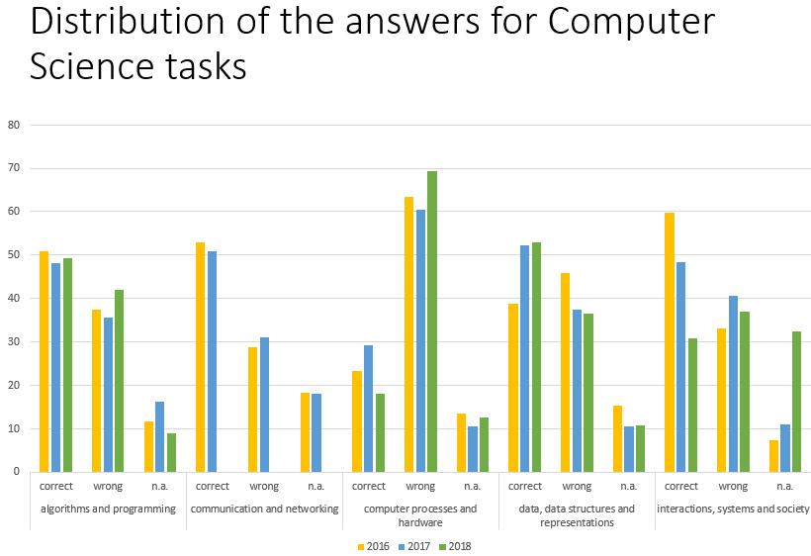

Slide 19
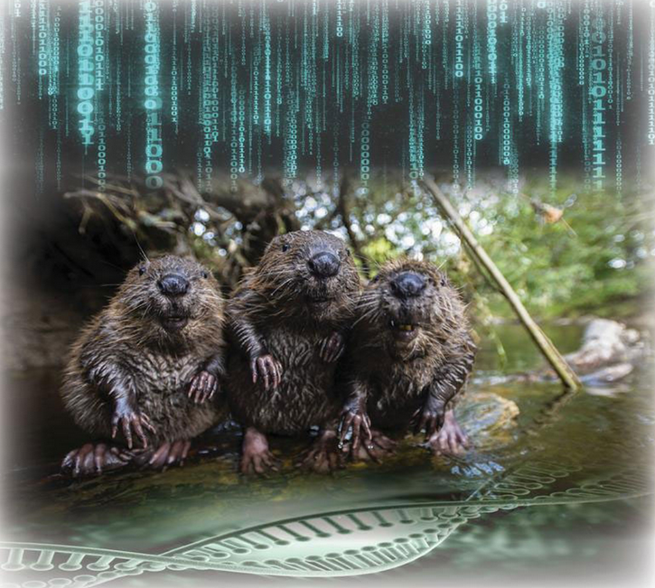
Nice figures and diagrams, for sure, much much work …, but are there any conclusions???
Source: https://www.derstandard.at/story/2000053553874/naechster-verwandter-des-bibers-gesucht

Slide 20
Austrian Bebras challenge and Computational Thinking domain
comparatively balanced number of tasks
some more tasks for ‘decomposition’ and ‘generalization’
Austrian Bebras challenge and Computer Science domain
only categories ‘algorithms and programming’ and ‘data, data structures and representations’ are very frequently represented
categories ‘communication and networking’, ‘computer processes and hardware’ and ‘interactions, systems and society’ only rare over three years
Maybe it is hard to find tasks for these three domains?
Do we need a a new categorization system? Or can we live with these imbalancies?
In some categories of the Austrian Bebras challenge the (performance) results are similar and relatively stable over three years

Slide 21
