Slide 1
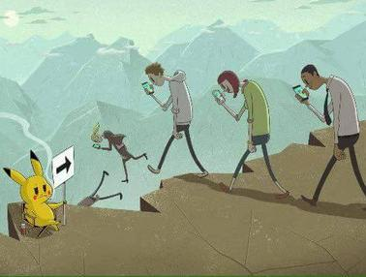
“Basic Digital Education” in Austria. One Step Further.
Peter Micheuz, Stefan Pasterk, Andreas Bollin

Slide 2
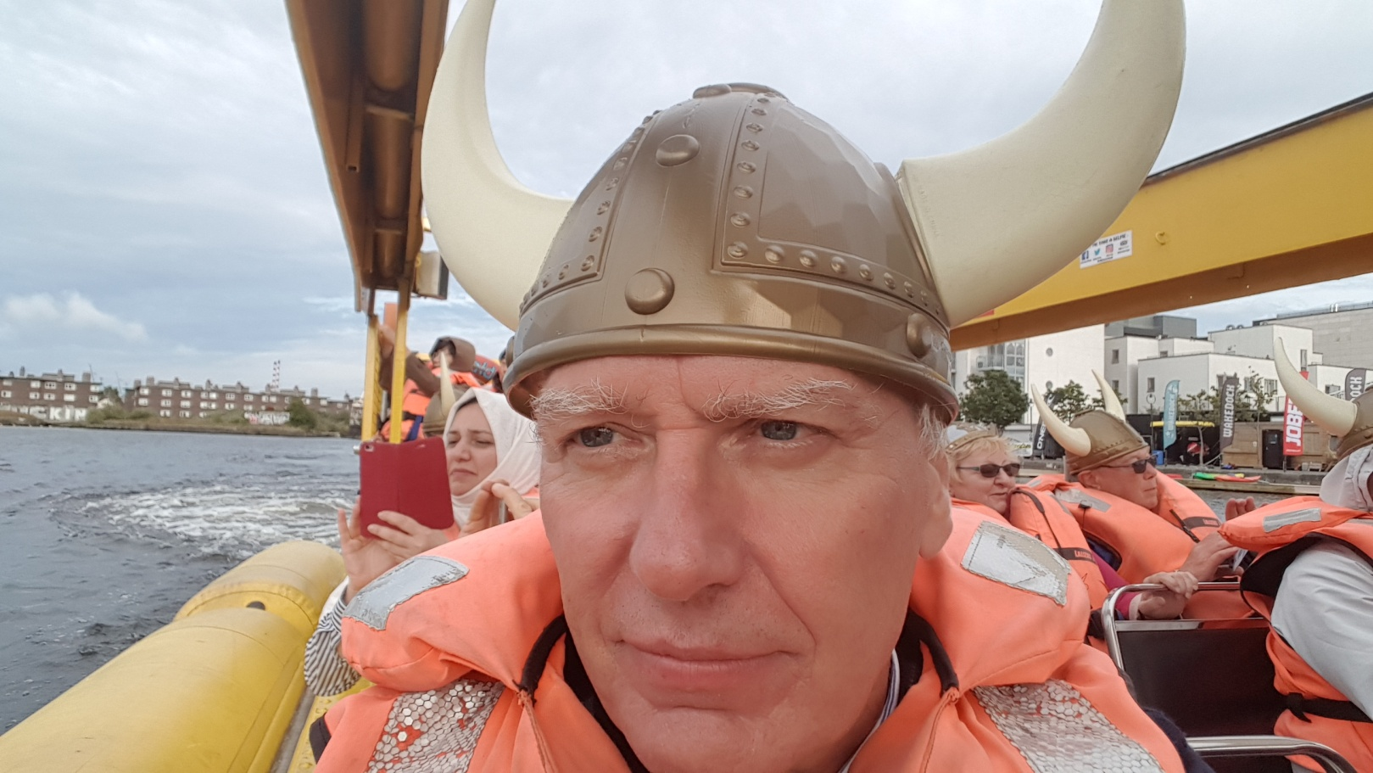
Peter MichEUz, Viking

Slide 3
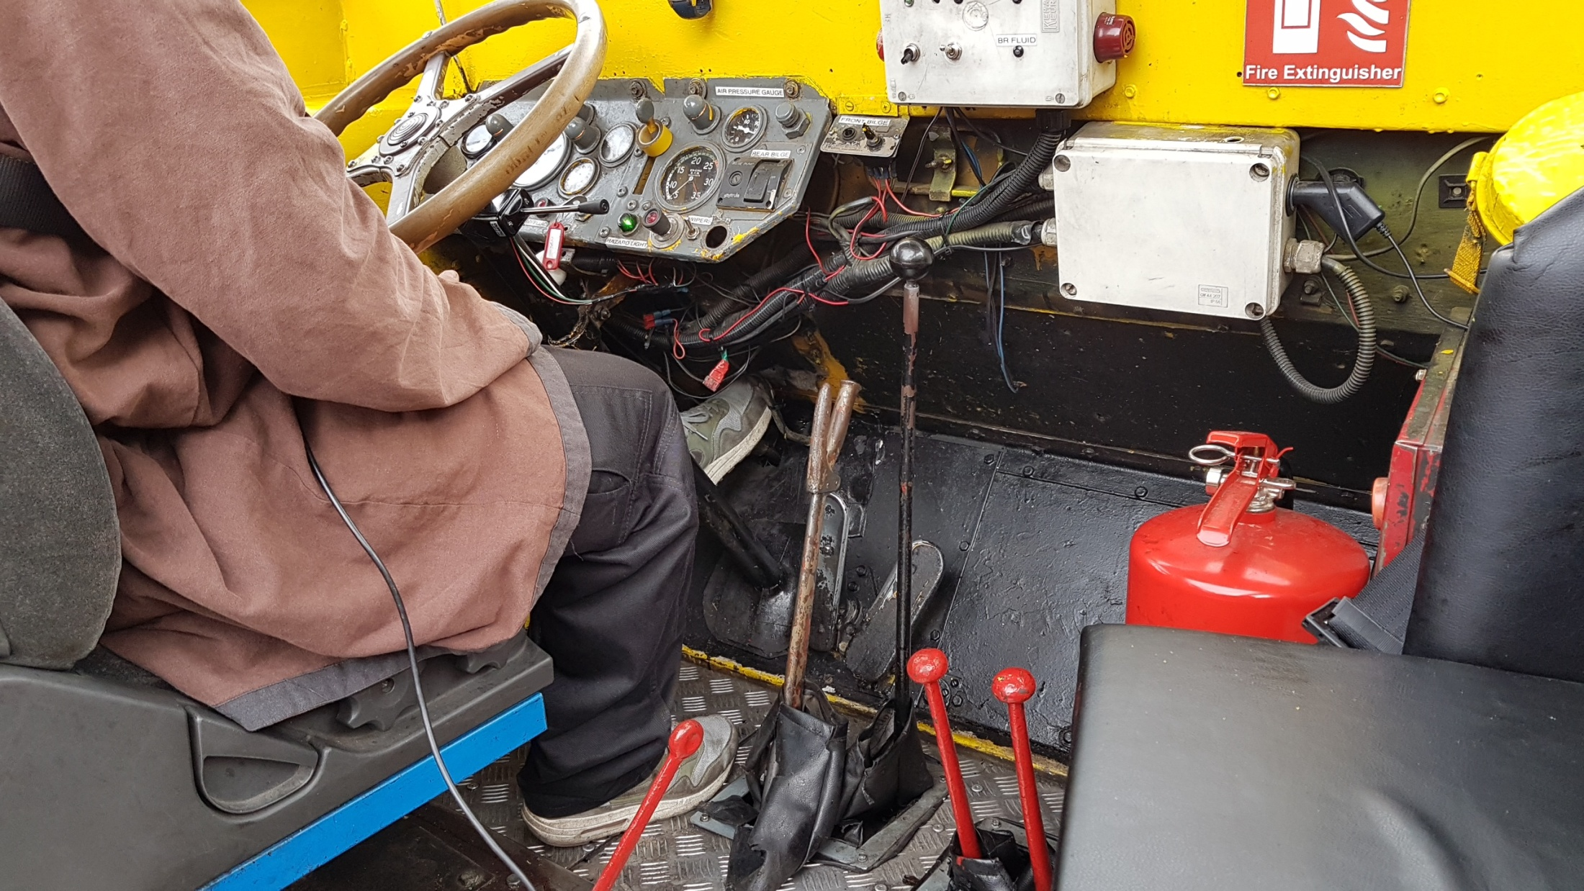

Slide 4
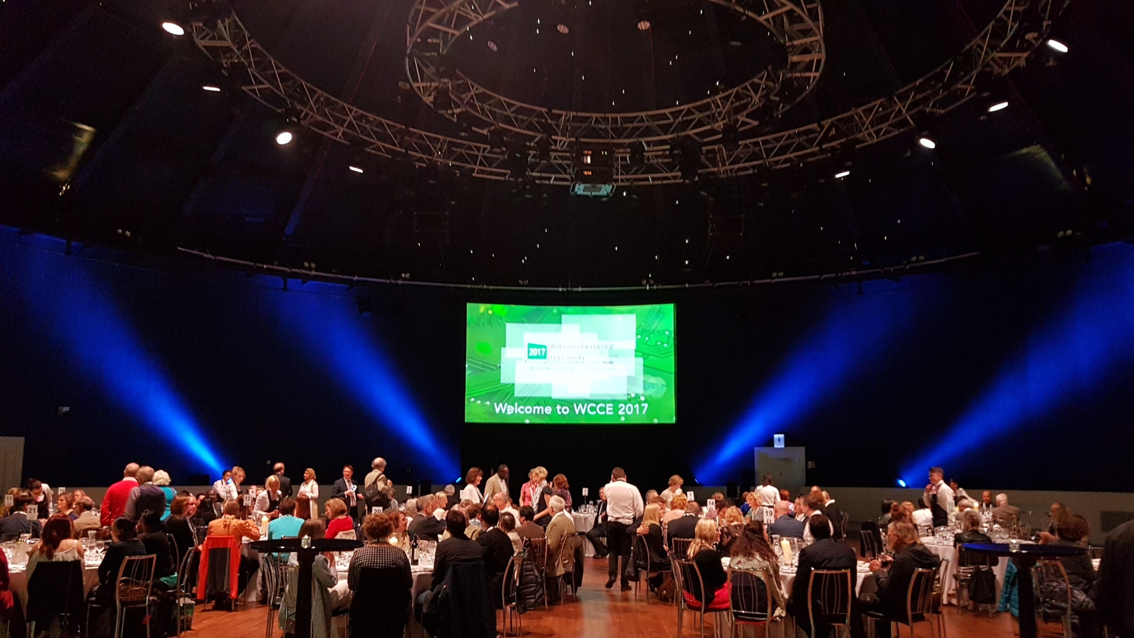

Slide 5
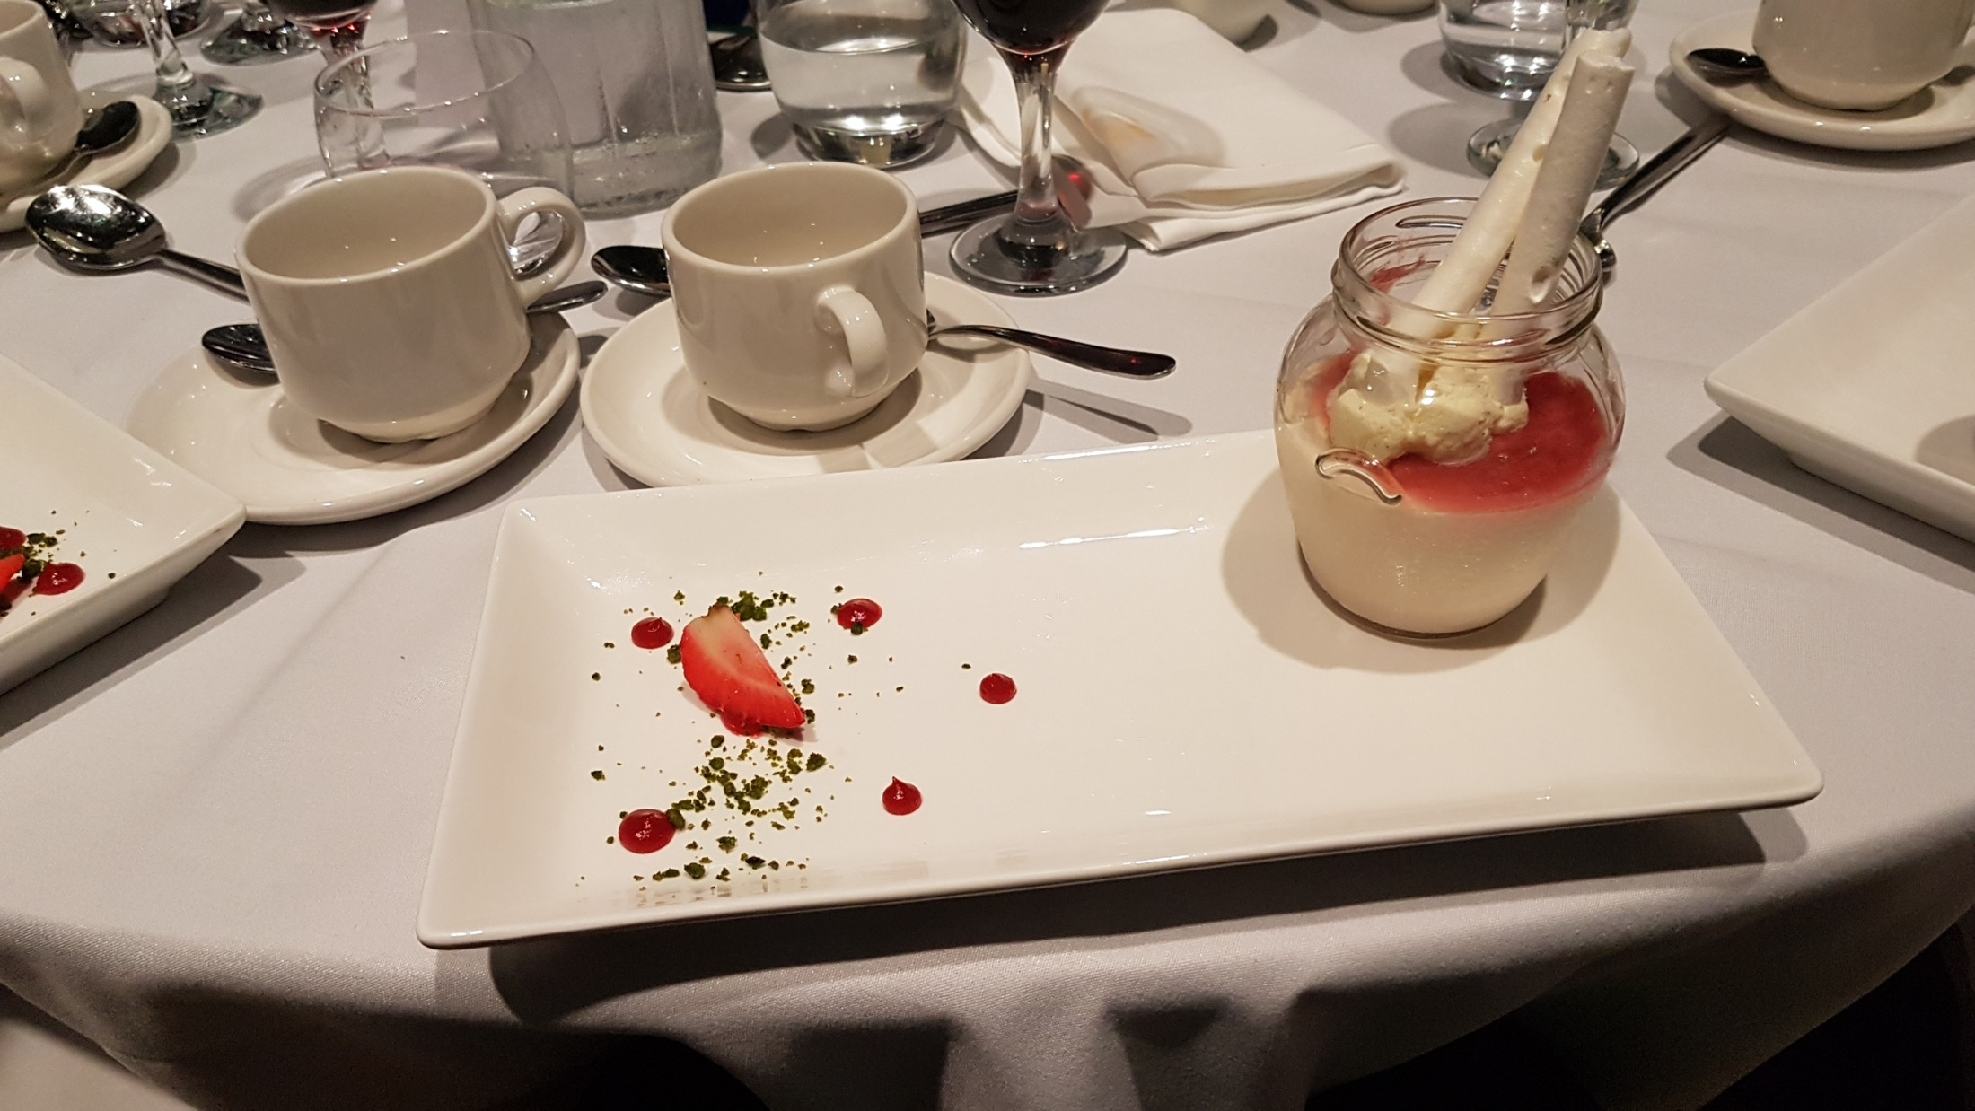

Slide 6
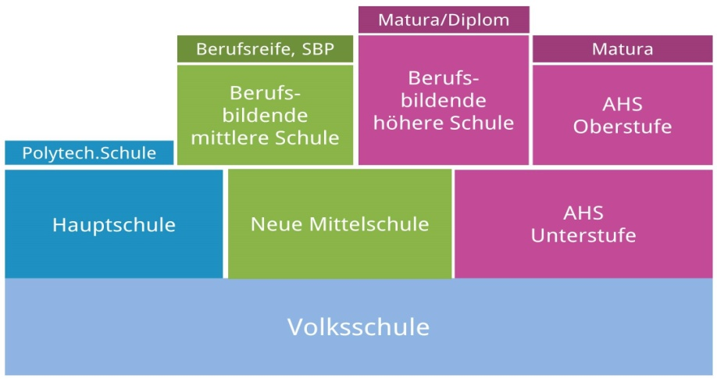
Digital Education in a Stratified School System
Upper Secondary Education Vocational Schools
Gymnasium
15-18/19
well structured and competence-oriented, detailed curriculum application based
Elective 10-12 grades
Obligatory (9th grade)
Lower Secondary Education
DISTORTIONS, NO SOLID STRUCTURE
10-14
top down recommendation, low commitment
diverse, autonomous
Primary Education
7-10
interventions, some outreach programs , very occasional

Slide 7
LOWER SECONDARY EDUCATION
GRADES 5 - 8
10-14

Slide 8
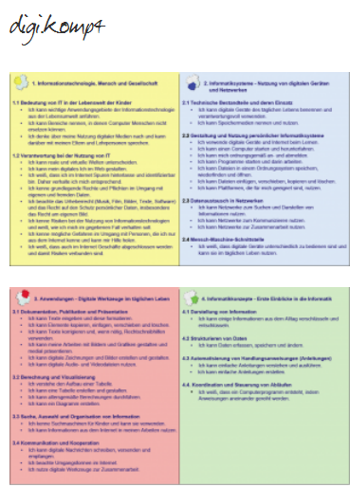
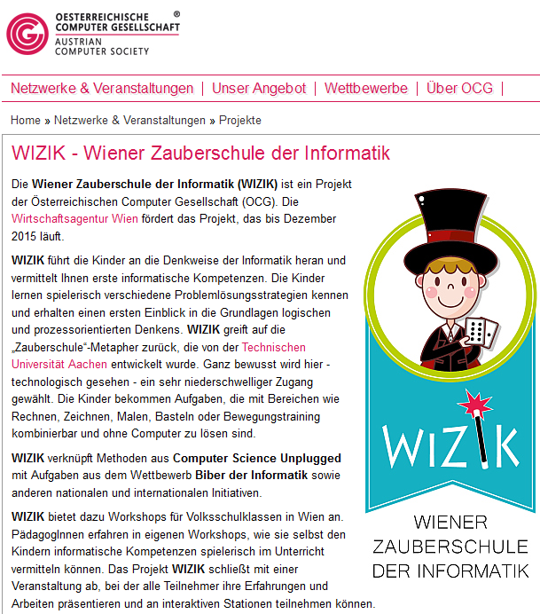
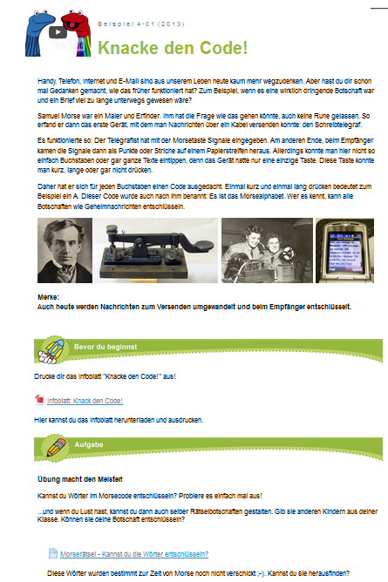
Primary Education
Formal Objectives
Mainly Non-Formal

Slide 9
30%
15%
10%
2
4
3%
0
8

Slide 10
Dreaming of a new Discipline/Subject
mandatory
sequenced, timed and age-appropriate
two hours a week – 4 years from grade 5 - 8
transdisciplinary
guaranteed integration into other disciplines
denotation of the subject/discipline ?
Media and Informatics? Digital Technologies?
Computing?

Slide 11
Situation 2005
The digital gap between pupils at the end of lower secondary schools is unacceptably wide.
Due to autonomy and inhomogeneous competences of teachers, the status of ICT/informatics differs extremely from school to school.
Simplification and clarification of terminology of ICT and Informatics are a matter of concern.
There is a need for a reasonable framework which ensures also a certain level of digital literacy.
Standardizing measures and clearly defined standard of digital and Informatics competence.

Slide 12
Birth of a new NATIONWIDE Discipline/Subject
mandatory YES AND NO
sequenced NO
timed and age-appropriate - HOPEFULLY YES
two hours a week – 4 years from grade 5 – 8 NO
transdisciplinary – NOT NECESSARILY
guaranteed integration into other disciplines NO
Denotation of the subject/discipline
BASIC DIGITAL EDUCATION

Slide 13
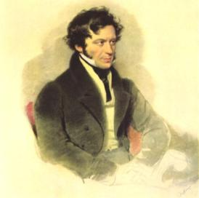
“That is the curse of our noble house: Striving hesitatingly on half ways to half action with half means. Yes or no, here is no middle road”.
Quote from the stage play “A Fratricidal Struggle in the House of Habsburgers”, written by the well known national Austrian poet Grillparzer (19th century)

Slide 14
BASIC DIGITAL EDUCATION YES OR NO NO GRADING

Slide 15
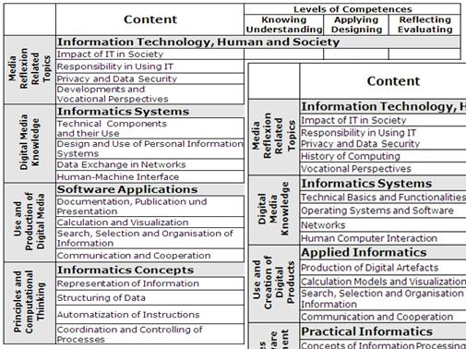
Competence Model for Lower Secondary Ed.
about 70 descriptors (I can … statements)
First release: 2011/2012

Slide 16
SINCE 2014 IN ENGLAND, SINCE 2017 IN AUSTRIA …
ENGLAND: „COMPUTING“ FORCING BACK IT FROM CURRICULA (practically)
DIGITAL EDUCATION FOR ALL (KS3)
AUSTRIA:
„BASIC DIGITAL EDUCATION“ „SUBJECT“ OR/AND INTEGRATION
„MANDATORY EXERCISES“ WITHOUT GRADING

Slide 17
CURRICULUM SINCE APRIL 2017
1 Social Aspects of Media Change and Digitization
2 (Re)Search and Learning Support
3 Instructions for Digital Devices and Basic Structure of Computers
4 Introduction into Information Technologies
5 Basics of an Operating System
6 Social Media
7 Word processing
8 Presentation and Media Design
9 Spreadsheets
Communication on the Internet
Computational Thinking
1 Social Aspects of Media Change and Digitization (15)
2 Information-, Data- and Media Competence (15)
3 Operating Systems and Standard Application Software (20)
Basics of Operating Systems (3)
Word Processing (5) Presentation (6) Spreadsheets (6)
4 Media Design (13)
5 Digital Communication and Social Media (17)
6 Security (9)
7 Technical Troubleshooting (12)
8 Computational Thinking (13) Working with Algorithms (7) Devising Simple Programs (4) Creative Use of Programming Languages (2)
ECDL
VERY FIRST DRAFT
115 descriptors
CODING

Slide 18
INTERMEZZO

Slide 21
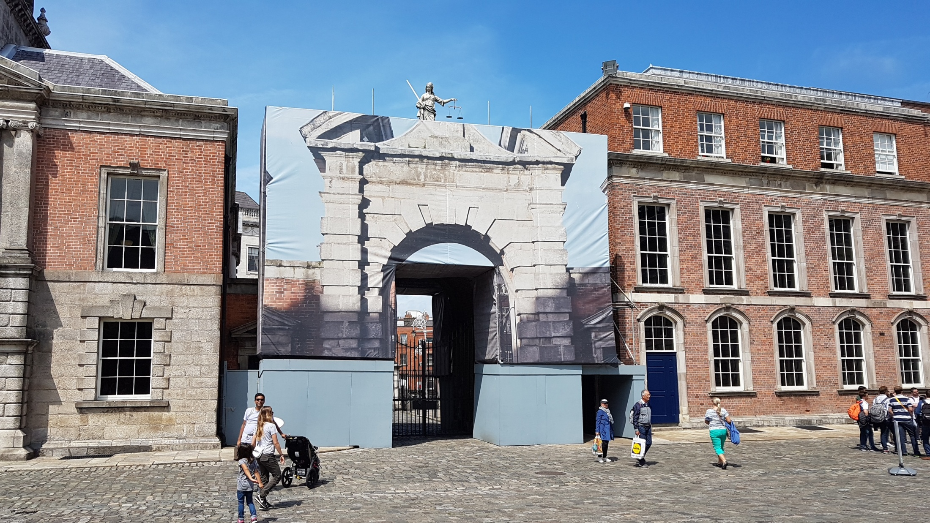

Slide 22
Computational Thinking
Working with Algorithms Pupils
name and describe everyday routines
use, create and reflect codes (cryptograhy, QR-code, …),
carry out unambigous practical instructions (algorithms)
discover similarities and rules (patterns) in instructions
recognize the importance of algorithms in automatic digitale processes (automatical recommendation of potentially interesting information),
can estimate intuitively user interfaces and the technical processes behind
formulate exact instructions (algorithms) verbally and in written form
Creating simple Programs
Pupils
know different programming languages and production processes
create simple programs in proper development environments in order to solve paticular problems or to accomplish particular tasks
master basic programming structures (alternatives, loops, procedures)
reflect the boundaries and potential of simulations
Creative Use of Programming Languages
Pupils
design web pages with HTML
use Fab-Lab projects, educational robotics and 3D-printing creatively

Slide 23
Concluding Notes and Comments
Piloting schools will have to decide
to introduce the subject “Basic Digital Education” (2-4 hours) as a Mandatory Exercise (very rare “construction”) 1-1-1-1, 1-1-2, 0-0-2-2, …..
or “no separate subject” and only Integration in other subjects
or both approaches
At the end of Lower Secondary there will be a „DIGICHECK“.
No sequenced curricula for grades 5, 6, 7, 8 (schools have to decide what and when)
No textbooks, only open educational ressources
What about schools which offer the subject Informatics with grading?

Slide 24
INTEGRATION?

Slide 25
SEQUENCING?

Slide 26
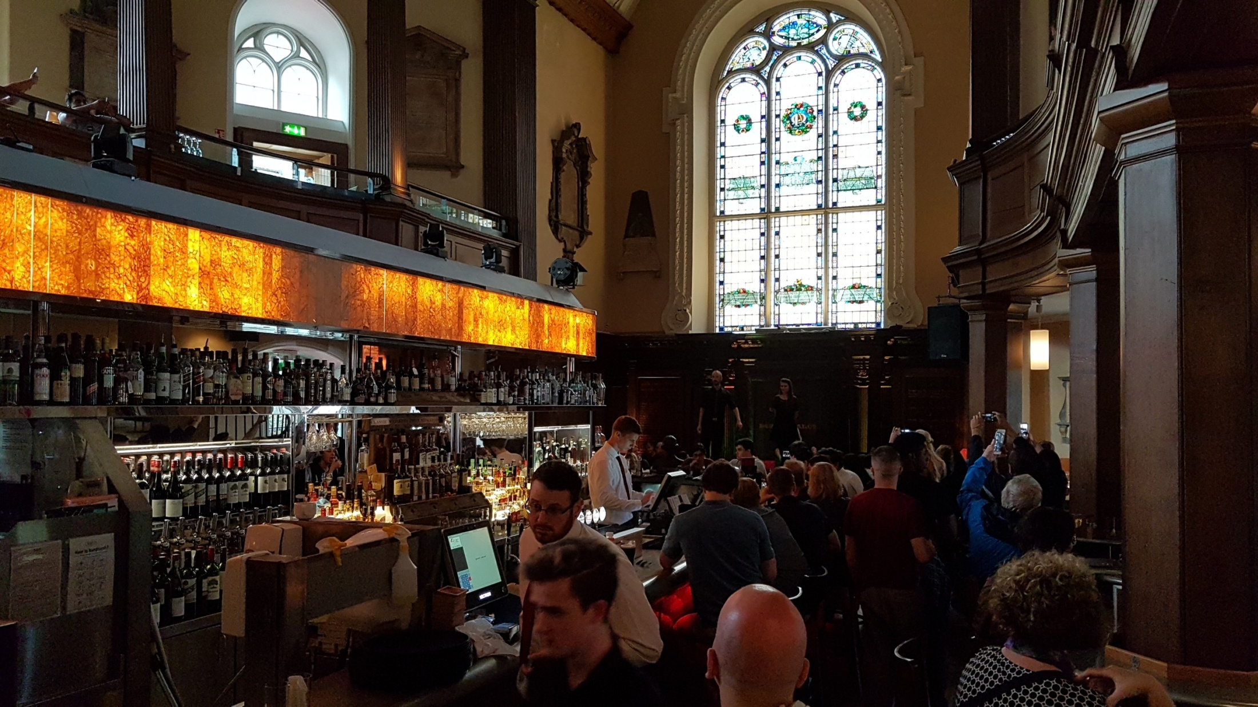
LET‘S PRAY …

Slide 27
WHAT WILL REALLY HAPPEN AND WORK AT THE BASIS? FOR RESEARCH,
THIS ROLLING OUT WILL BE AN

Slide 28
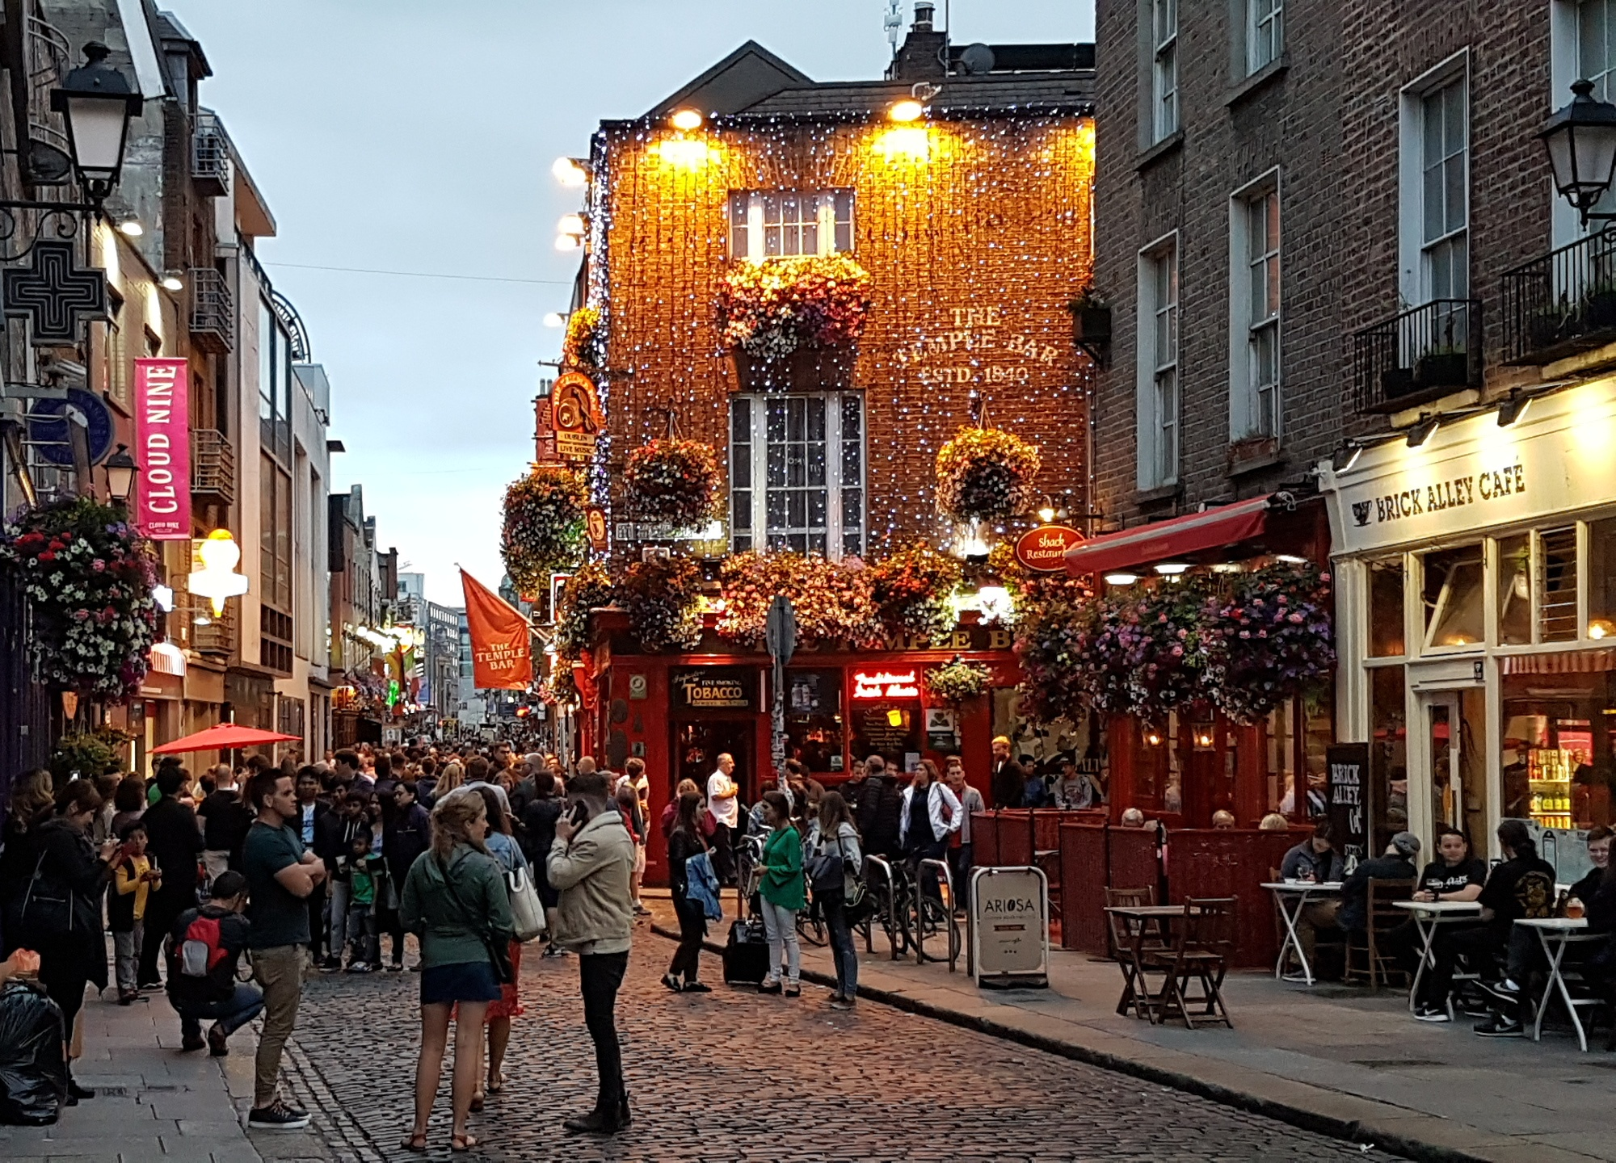
THANK YOU FOR
VIEWING AND LISTENING

Slide 29
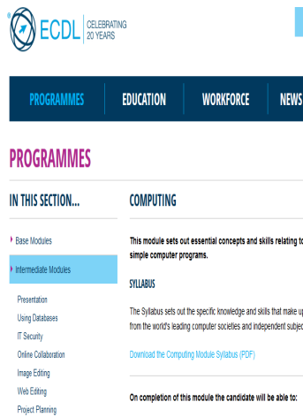
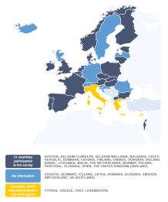
FURTHER MATTER OF CONCERNS FOR IFIP? BEYOND AUSTRIAN AFFAIRS …
Participating countries
Canada (Alberta), Chile, Denmark, Finland, France, Germany, Italy, Kazakhstan, Korea, Luxembourg, Portugal, Russian Federation (Moscow), Uruguay, and the United States.

