Slide 1
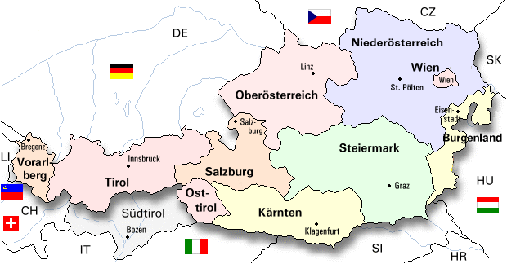
Some results and remarks of the Austrian jury …
Peter Micheuz
Institut für Informatiksysteme, Forschungsgruppe Informatikdidaktik

Slide 2
Rough Overview
1.200.000 students in total, about 800.000 in the „beaver – age“ 6000 schools, about 3200 are primary schools -> more than 2000 are potential „beaver schools“ …

Slide 3
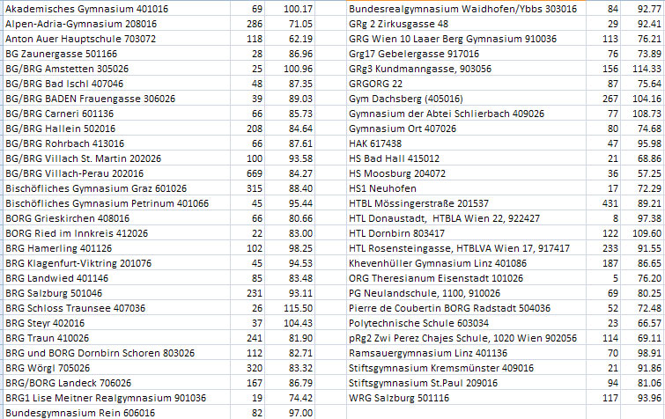
Statistics
55 schools took part this year, with ca. 6300 students

Slide 4
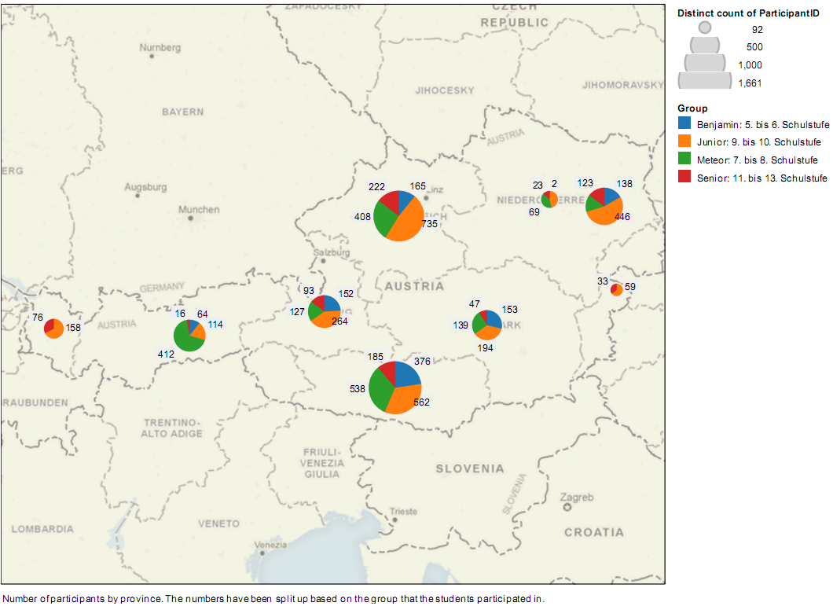
Participants by Provinces

Slide 5
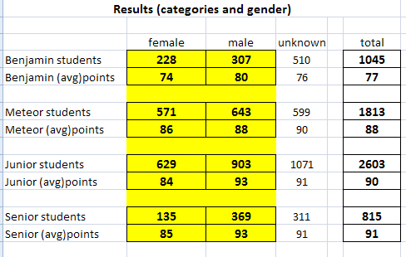
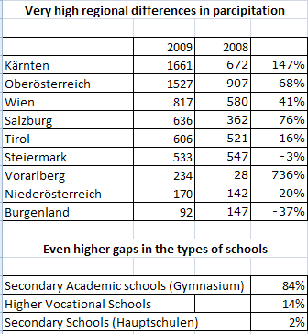
Statistics

Slide 6
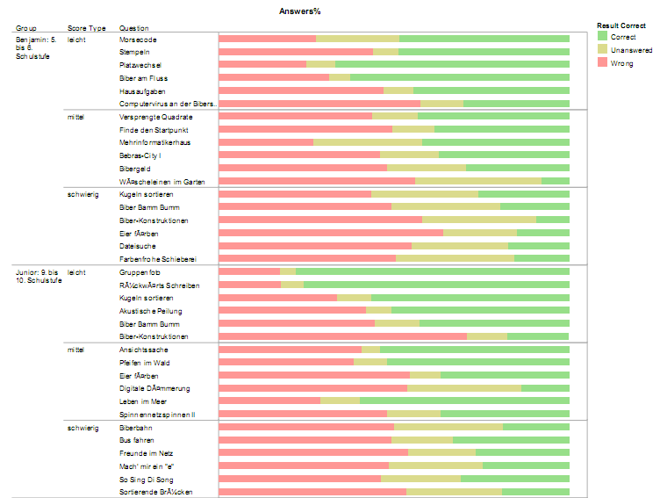
From easy to difficult and vice versa …

Slide 7
Further facts
Average points per student female male 2008: 96 104 2009: 83 90
Feedback from the school coordinators (feedback rate 40%) The tasks have been appreciated very well (55% very good, 45% good) Unpleasant technical problems in many (60%) schools
Performance dependent from day and time of day

Slide 8
Beaver: finish
Thank You! Questions?
Thank You for your interest!

