Slide 1
Curricula for Digital Education as a Moving Target
Introduction
Past
Present
Future
The Austrian Patient
01000111 01111001 01101101 01101110 01000010 11100110 11010010 11101010 11011010 01000000 10101101 10000111 01101100 11011000 11010110 11001010 11100100 11011010 11000010 11100100 11010110 1110100
peter.micheuz@aau.at

Slide 2
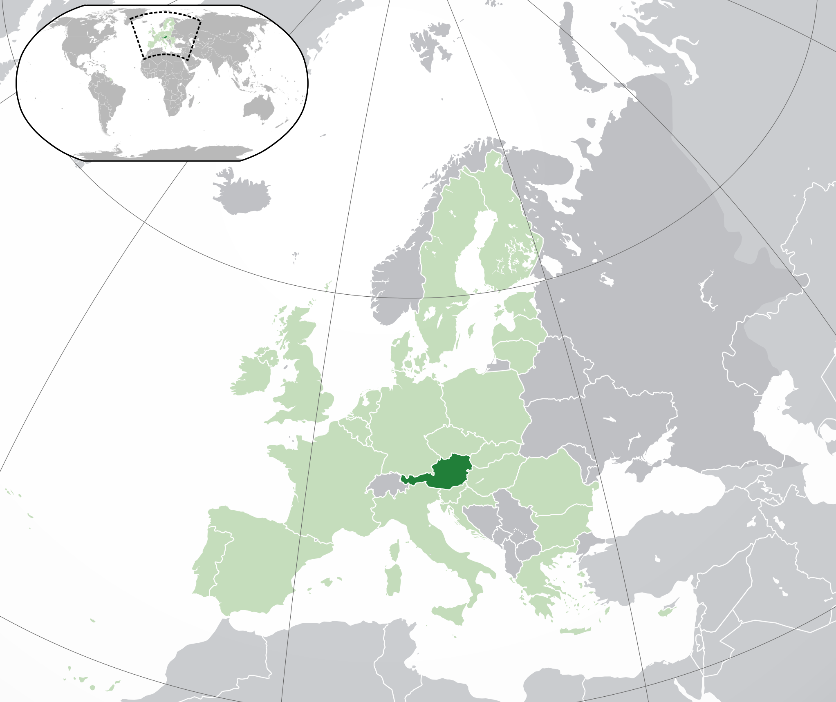
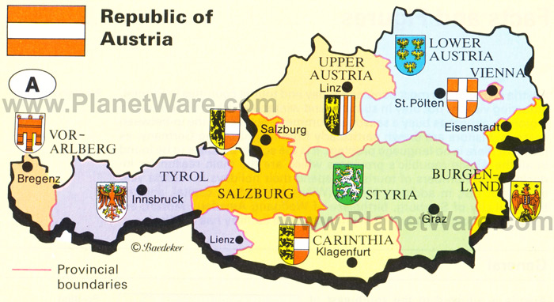
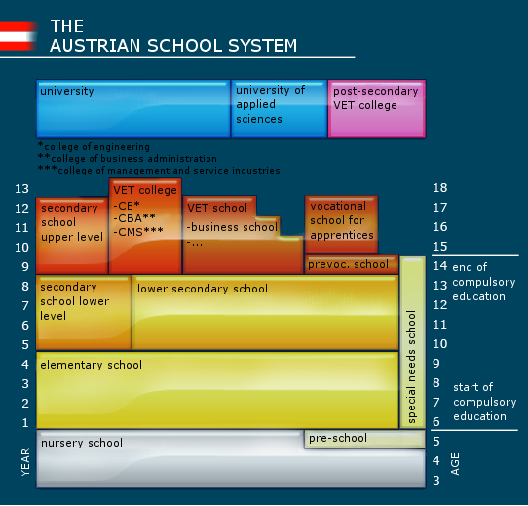
Austria
~ 9 Mill. inhabitants
~ 1,1 Mill. Pupils
~ 120.000 teachers
General Education Primary (6/7 - 10) Lower Secondary (10/11 - 14)

Slide 3
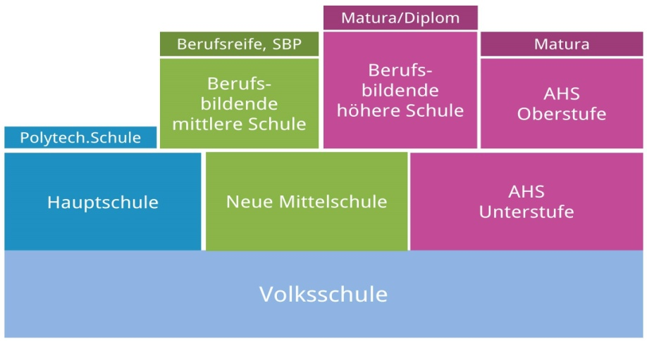
„Informatics“ in a stratified Austrian school system
Upper Secondary Education Vocational Schools
Grammar School
well structured and competence-oriented, detailed curriculum application based
15-18/19 years
Elective 10-12 grades
Upper secondary Grammar School
Mandatory Informatics Informatics(9th grade)
DISTORTIONS, NO SOLID STRUCTURE
Lower Secondary Education (ca. 350.000 pupils)
Middle School
Grammar School Lower Secondary
10-14 years
since 2018 top down curriculum with autonomous implementation
Primary Education
7-10 years
interventions, some outreach programs, very occasional

Slide 4
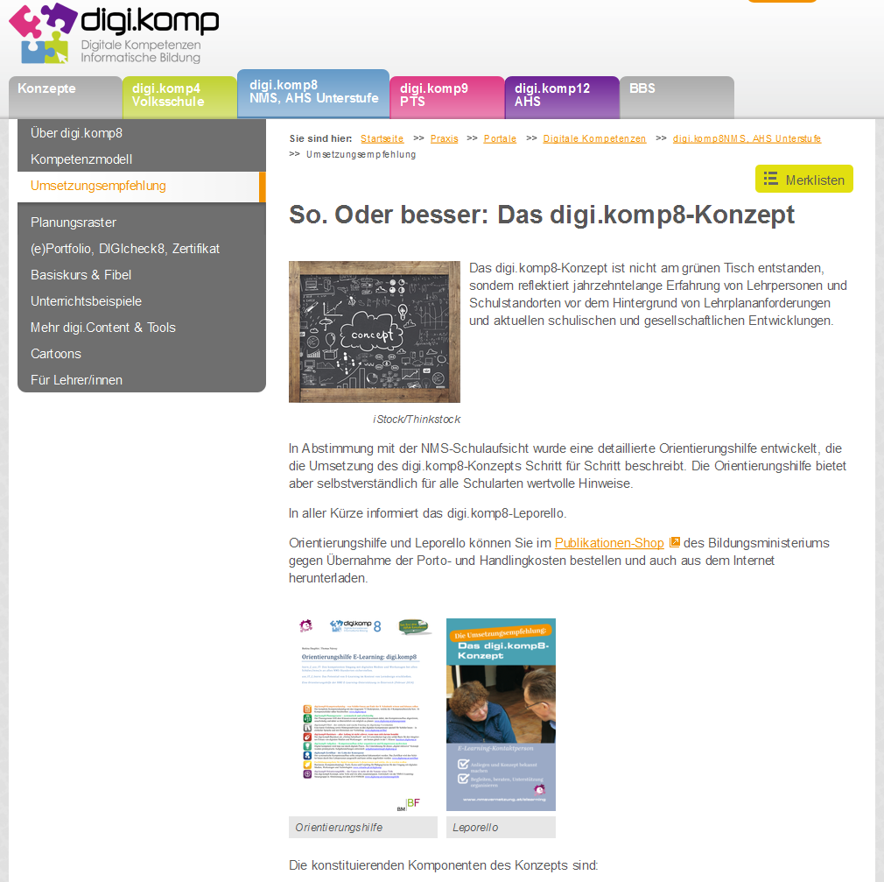
Before 2018: No binding national curriculum, but a competence model and a vague implementation concept
for lower secondary education (10-14 years)
http://www.digikomp.at

Slide 5
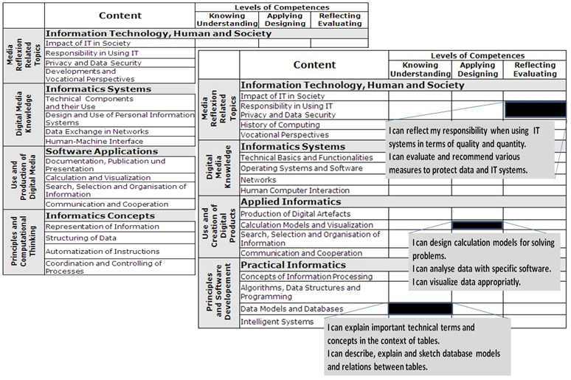
Competence Models for General Education
Lower Secondary Level (10-14 years, KS 3) [ Primary Level (6 – 10 years, KS 2) ]
First release: 2011/2012
Upper Secondary Level (15-18, KS 4,5)

Slide 6
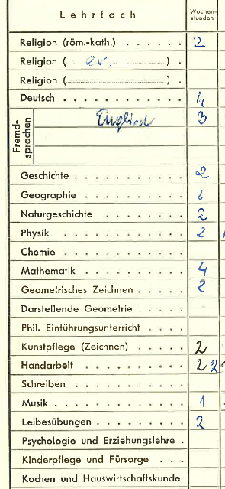
Lower Secondary Education (10-14 years)
Patchwork
Big Survey 2007 (Gymnasium, Grammar School)
4 x 2 hours
~ 1/3 of pupils without Informatics lessons
Dreaming of a new Discipline/Subject
obligatory
sequenced, timed and age-appropriate
two hours a week – 4 years from grade 5 - 8
transdisciplinary
guaranteed integration in other disciplines
Denotation of the subject/discipline
Media and Informatics? Digital Technologies?
Computing?

Slide 7
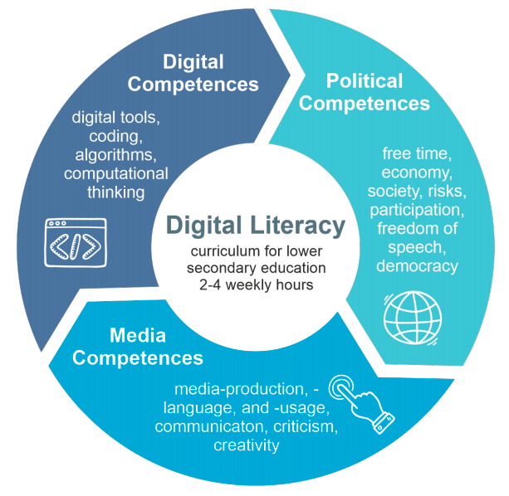
Subject „Basic Digital Education“ since 2018
The mandatory exercise „Basic Digital Education“ is implemented by schools in the lower secondary level autonomously.
An enacted curriculum defines the subject matter framework.
Schools decide for themselves whether to teach this subject in special lessons or integrated into other subjects.
Within the scope of two to four hours per week over a period of four years, students acquire competencies in the following areas.
FIRST DRAFT …
1 Social Aspects of Media Change and Digitization
2 (Re)Search and Learning Support
3 Instructions for Digital Devices and Basic Structure of Computers
4 Introduction into Information Technologies
5 Basics of an Operating System
6 Social Media
7 Word processing
8 Presentation and Media Design
9 Spreadsheets
Communication on the Internet
Computational Thinking
1 Social Aspects of Media Change and Digitization
2 Information-, Data- and Media Competence
3 Operating Systems and Standard Application Software
Basics of Operating Systems
Word Processing Presentation Spreadsheets
4 Media Design
5 Digital Communication and Social Media
6 Security
7 Technical Troubleshooting
8 Computational Thinking
Ca. 100 descriptors

Slide 8
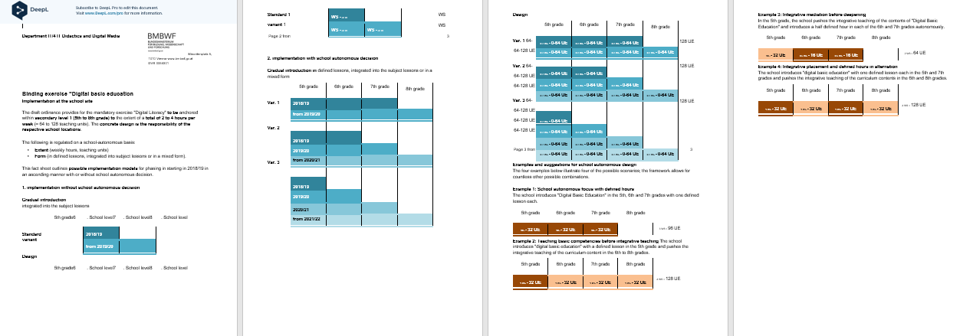
Official documents: Subject Basic Digital Education in Middle and Grammar school (Lower Secondary, Grades 5-8)
Official Curriculum law/regulation (25 pages!)
Nationwide ~ 1500 different realizations in 1200 middle and 300 grammar schools
Implementation concept, varying from full integration to a mandatory subject
Wild growth, no english lawn!

Slide 9
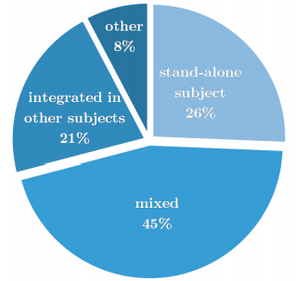
Some results from interim evaluation studies
Way of implementation
Acceptance of the current curriculum is mixed.
Experts' wish for a nationwide introduction of a compulsory subject is evident. A vast majority suggests 1-2 weekly lessons in all four grades 5-8.

Slide 10
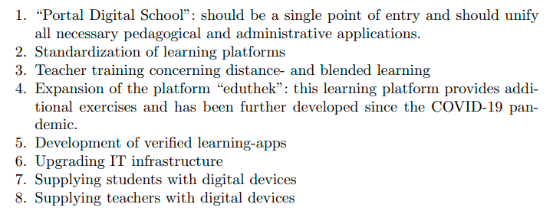
Current focus: “ 8-points-plan“
Priorities expressed by teachers

Slide 11
The next “big thing“ …
New curricula for primary and lower secondary schools
Including (again?) a new curriculum (still “TOP SECRET“) Basic Digital Education with a new content design
Still as a „Mandatory Exercise“ and no full subject
Open official review phase should start in 2021/2022
Enactment presumably as of schoolyear 2023/2024

Slide 12
Questions and attempted answers …
What is driving the emphasis of specifications for informatics science curricula (in Austria)? Growing general awareness of digitization (economic and societal -> political)
Dilemma or the silver bullet? The broad subject “Basic Digital Education” Demarcation and mixing of terms: Informatics - Digital Literacy - Media education
What do we know about how students learn some of the core concepts and processes of informatics that will enable us to design structure and progressions in curricula? Honestly, we know still very little … in contrast to (some or all?) traditional subjects
How should we incorporate new challenges associated with rapid developments in artificial intelligence and machine learning into informatics curricula? In a low-threshold, seamless and cautious way – beware of falling into a hype trap!
What is the relationship between an informatics science curriculum and other academic disciplines?
In the long term, if the canon of fragmented subjects and “Taylorism” in school organization will remain/be prevalent, there should be parity with other subjects (there is a sufficient body of knowledge!)

Slide 13
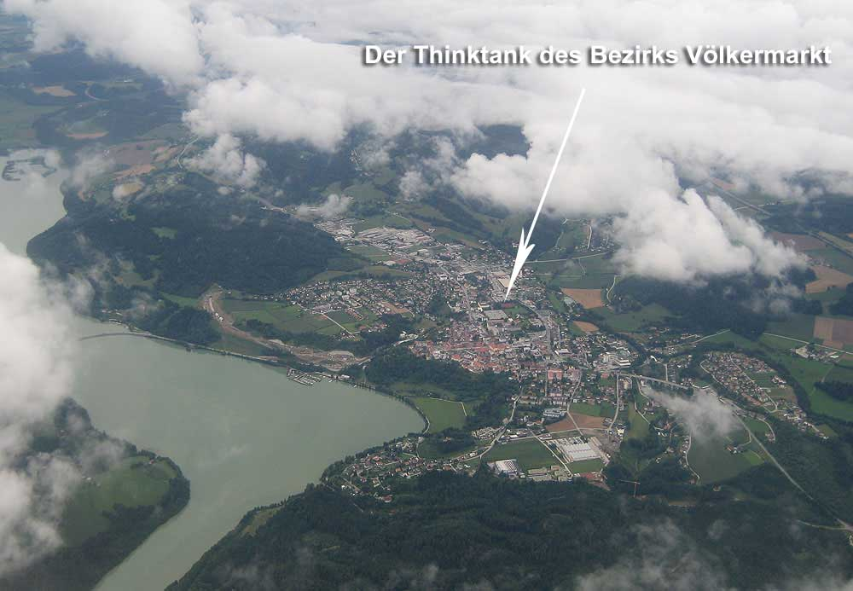
Everything is a matter of perspective…
My home is my castle.
The school was my destiny.

Slide 14
The hardest thing to learn in life is which bridges to use and which to tear down. Source: Unknown

Slide 15
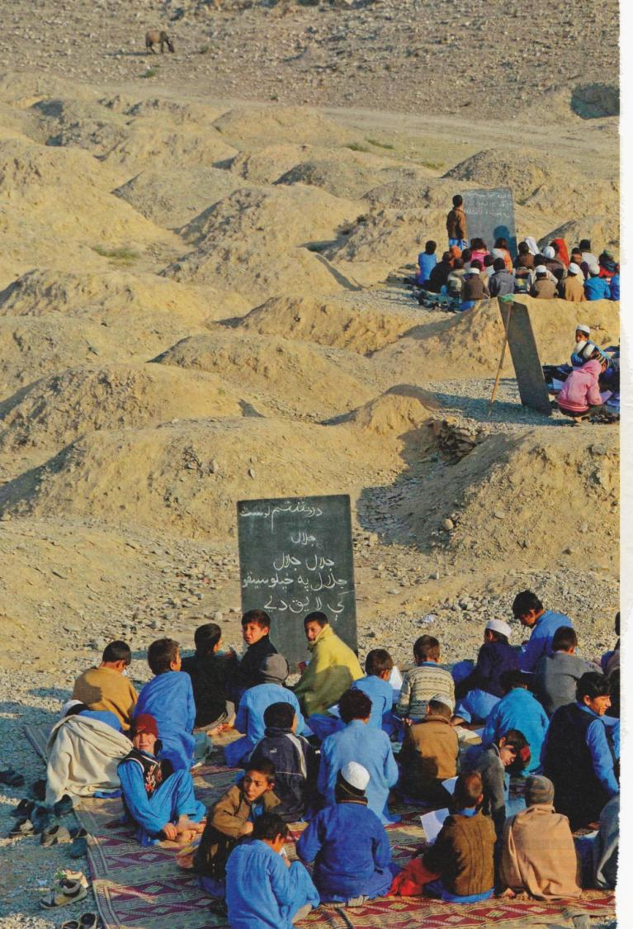
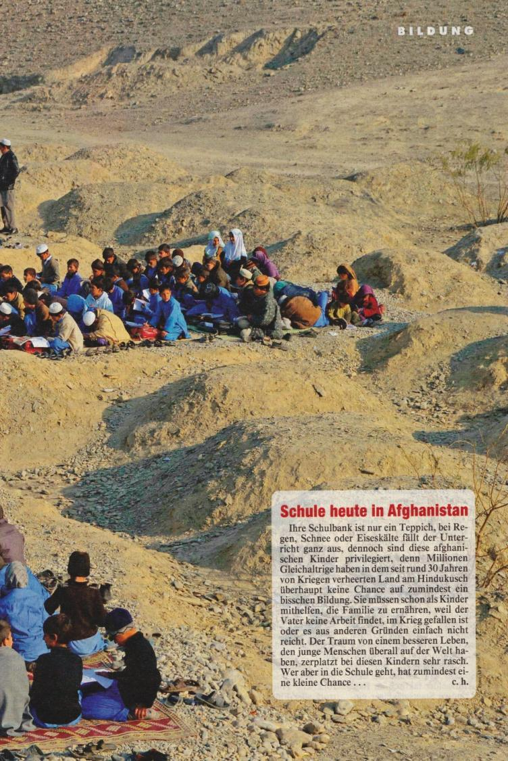
Education without any boundaries …
So much sand, and yet no chips …
By the way, the QR-Code means: I am vaccinated!
Any questions?
CS Unplugged and Beaver are nice …
© Kronenzeitung

